Slide 1
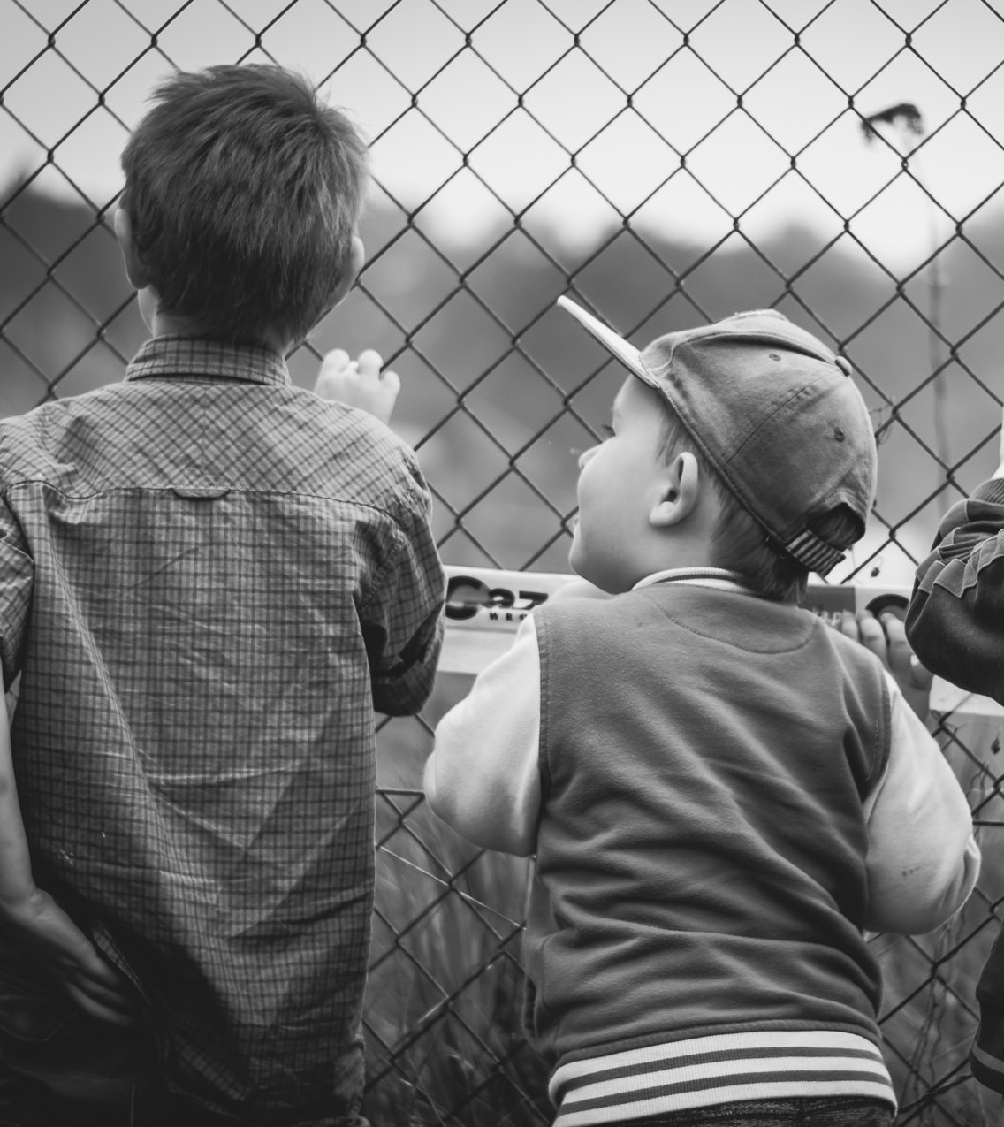
How Trauma Impacts Ongoing Behaviour
RTLB Wellbeing
10th August 2023
PRESENTED BY:
Kathryn Berkett
MEdPsych
Neurosequential Model of Therapeutics Practitioner

Slide 2
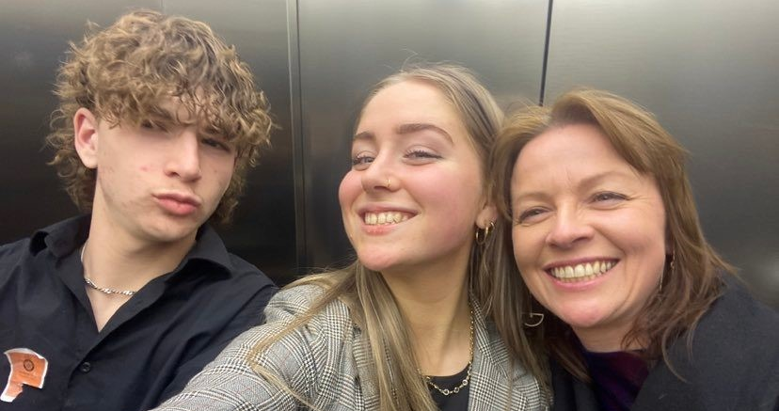

Slide 3
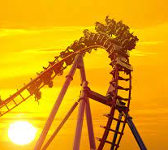
Defining Trauma
EVENT - what occurred in the environment
EXPERIENCE – How did their brain and body experience the event
EFFECT – Is there an ongoing effect

Slide 5
INTRODUCING THE BRAIN
UPPER/GREEN BRAIN
Over-ride Impulses
Plan
Sequence
Time Management
Abstract
Empathy
Survival Tasks
Impulsive
Irrational
‘Two years old’
Selfish
LOWER/RED BRAIN

Slide 6
ACTIVATING THE
STRESS RESPONSE
Neuroception
“AM I SAFE?”

Slide 7
ACTIVATING THE
STRESS RESPONSE
INCREASED CHANCE GOING TO
DIE
STRESSOR

Slide 8
DEFENCE RESPONSE
(Fight/Flight +Anxious + Nervous +…..)
Sight and Hearing Sharpen
Dry Mouth
Breathing Changes
Heart Beats Faster
Temperature Change
Stomach purges
Pores Constrict
Bowel/Bladder may empty
Blood increase in large muscles of arms & legs

Slide 9
COLLAPSE RESPONSE
(Freeze)
Eyes can look fixed / spaced out
Facial Expressions Blank
Breathing Slows
Heart Beats Slower / Blood Pressure Drop
Temperature Drops
Blood pools in the core, moving away from large muscles of arms & legs
May feel low or no pain

Slide 10
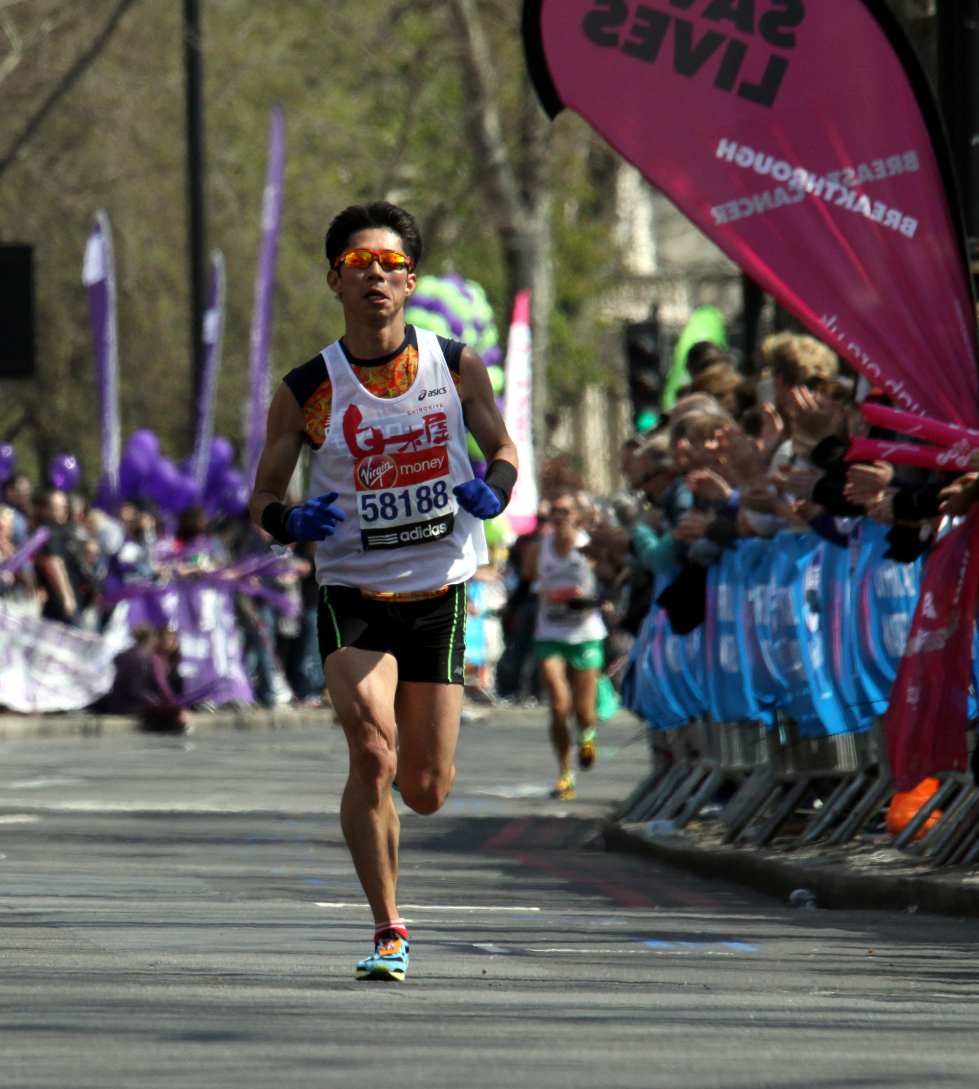
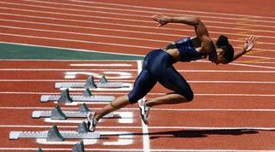
Marathon Runner
Sprinter

Slide 11
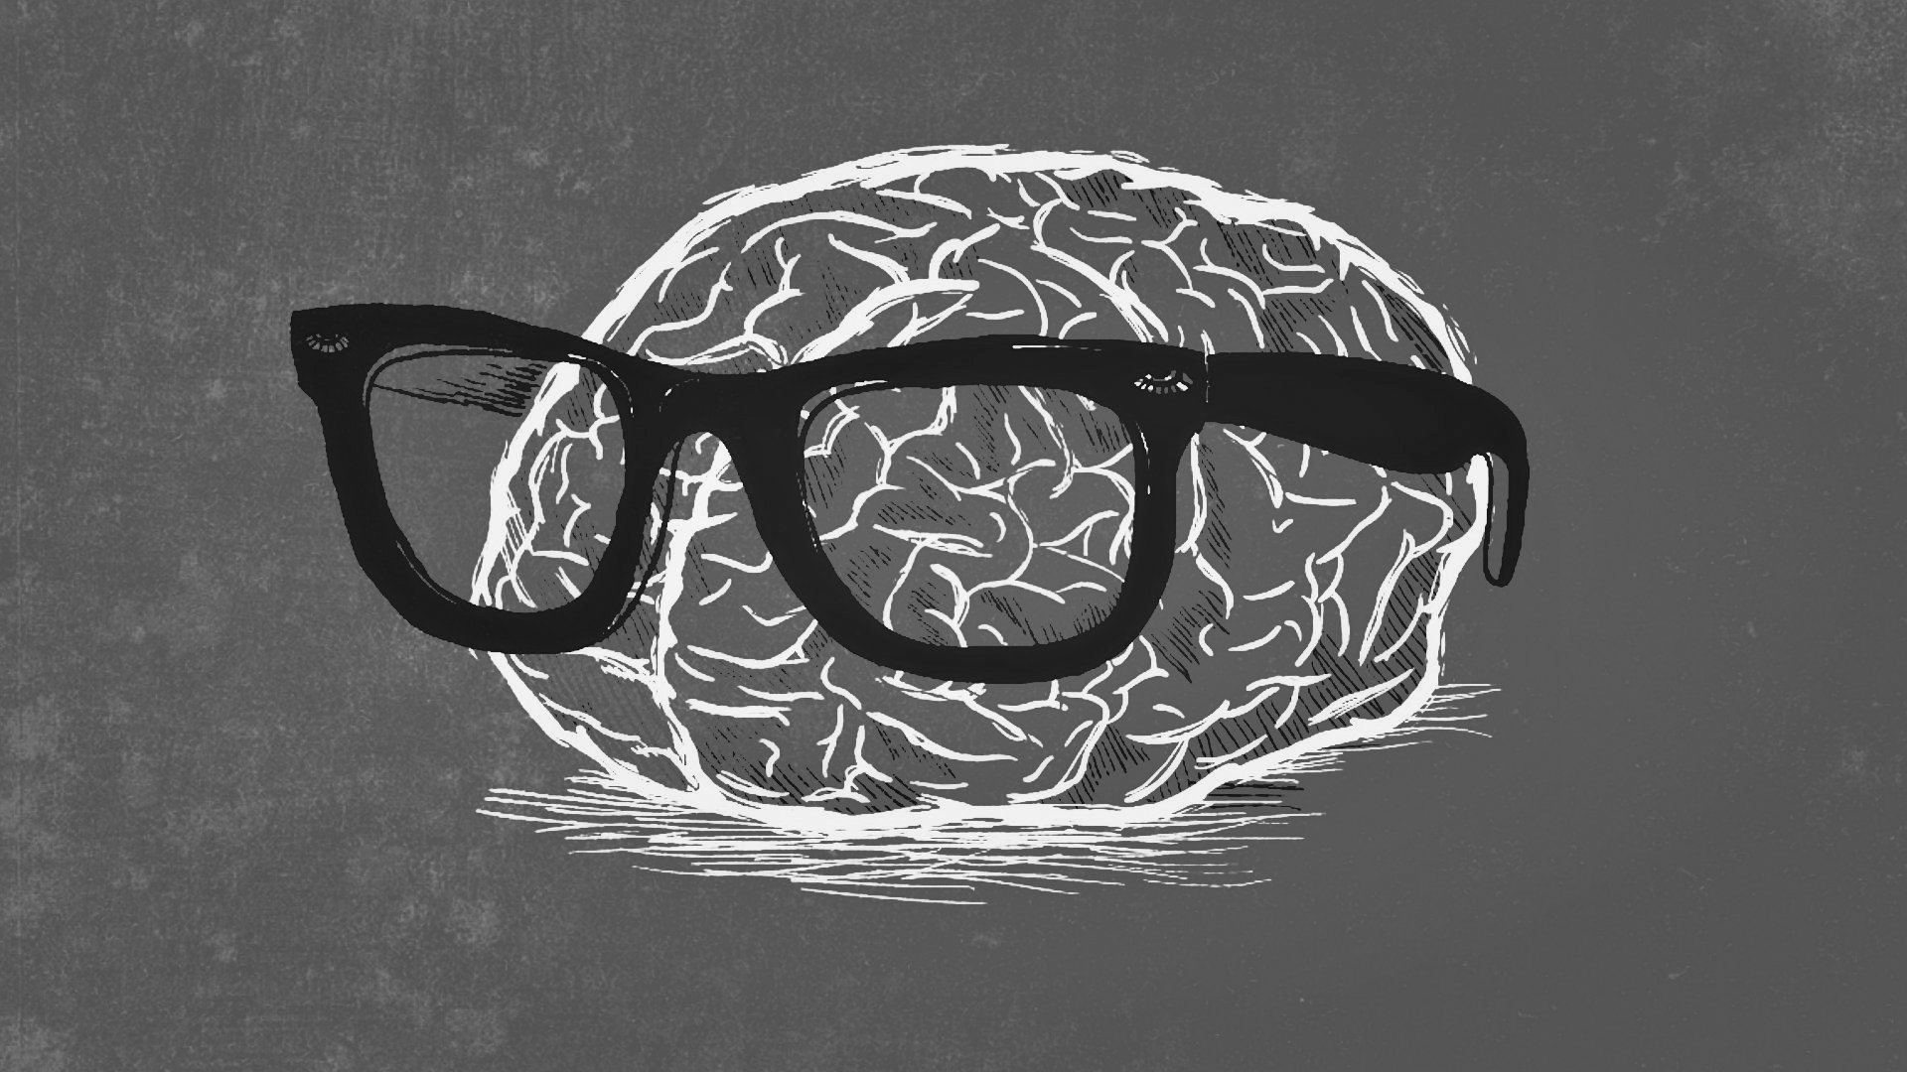
HOW TO KEEP THE SURVIVAL BRAIN CALM
Some
Boys
Have
Mullets
See me….
Show me I Belong….
Tell me what is Happening
Empower my Mana

Slide 12
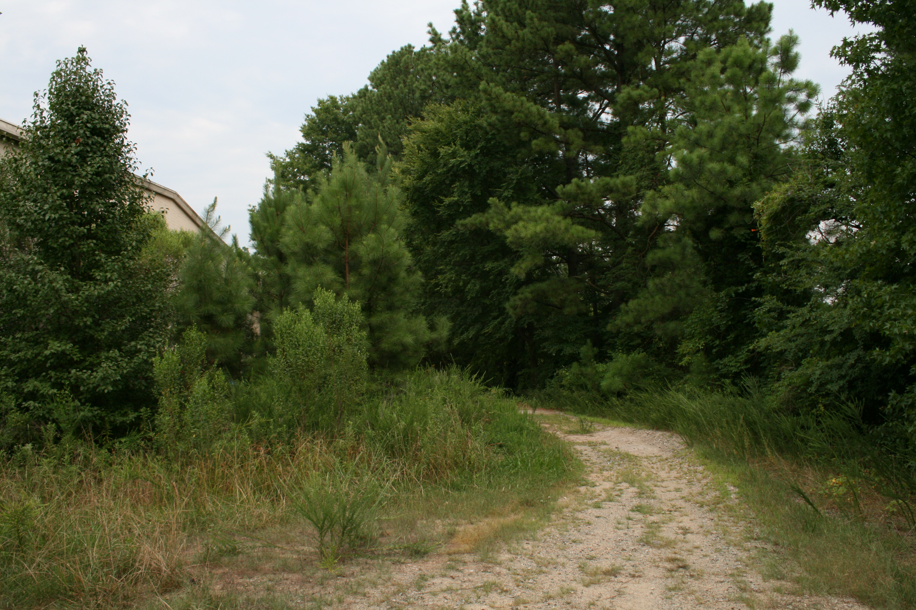
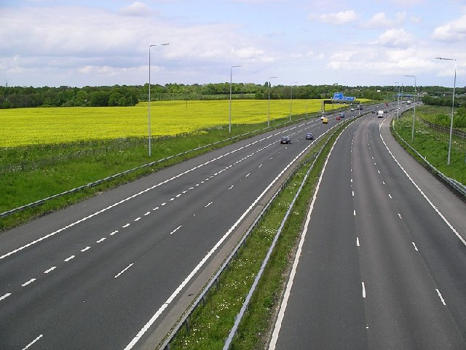
HOW THE BRAIN CONNECTS
Myelin
The More Repetitions = More Myelination = It Will Happen Faster
What We See/Hear/Feel More Often = What Our Brain Will Learn

Slide 13
What does a dog say?
Template Development

Slide 14
Consider someone you have been supporting for over six months:
How Often? (do they activate into stress response)
How Long? (do they maintain the stress response)

Slide 15
To Support Improvement…
How Often = Increase safety
How Long = Increase individual’s capacity to activate calm (resilience)

Slide 16
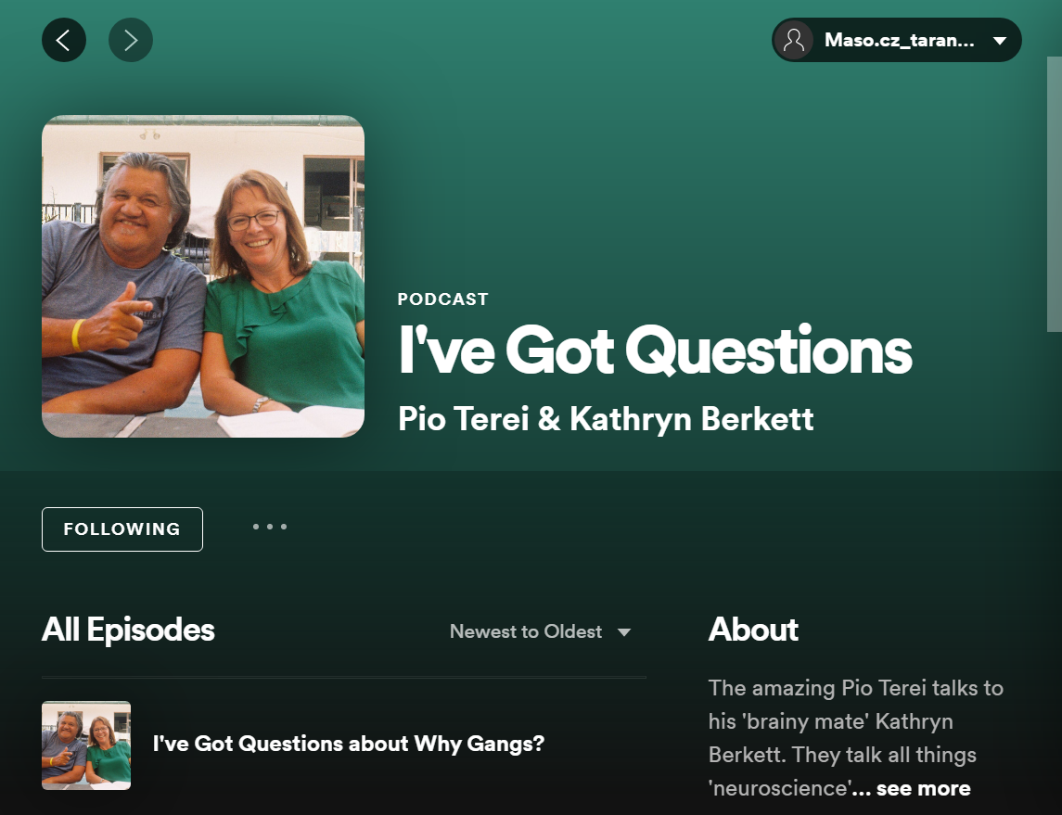
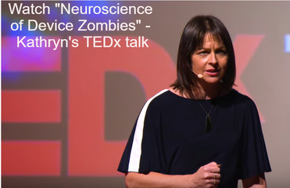
For More Information check out engagetraining.co.nz
www.facebook.com/EngageKB
Podcasts
TEDx Talk

