Slide 1

NGĀ MANU ĀWHINA
Standing Strong Together in Wellbeing
Thursday 10th August
He Pikorua in Action
Alison Leversha – Community Paediatrician
alisonl@adhb.govt.nz
Notes:
Trauma / Adversities
- Our growing need to challenge traditional ideas around trauma
ACES :
- recognising the legacy that experiencing extremely stressful event has a child growing up and altering their brain structure, health and immune system later in life.
Brain
- A brain will chose survival over learning every time
Resiliency & the power of relationships
- “Every kids deserves a champion; an adult who will never give up on them”

Slide 2
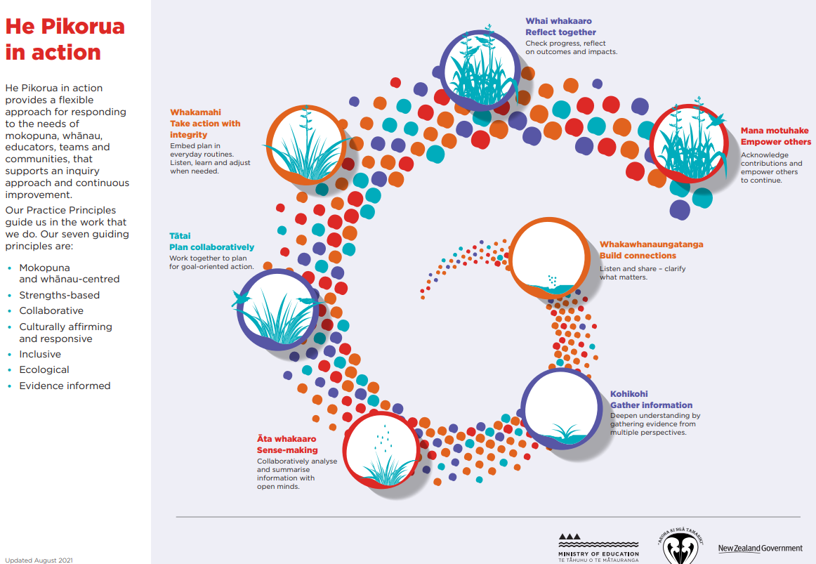

Slide 3
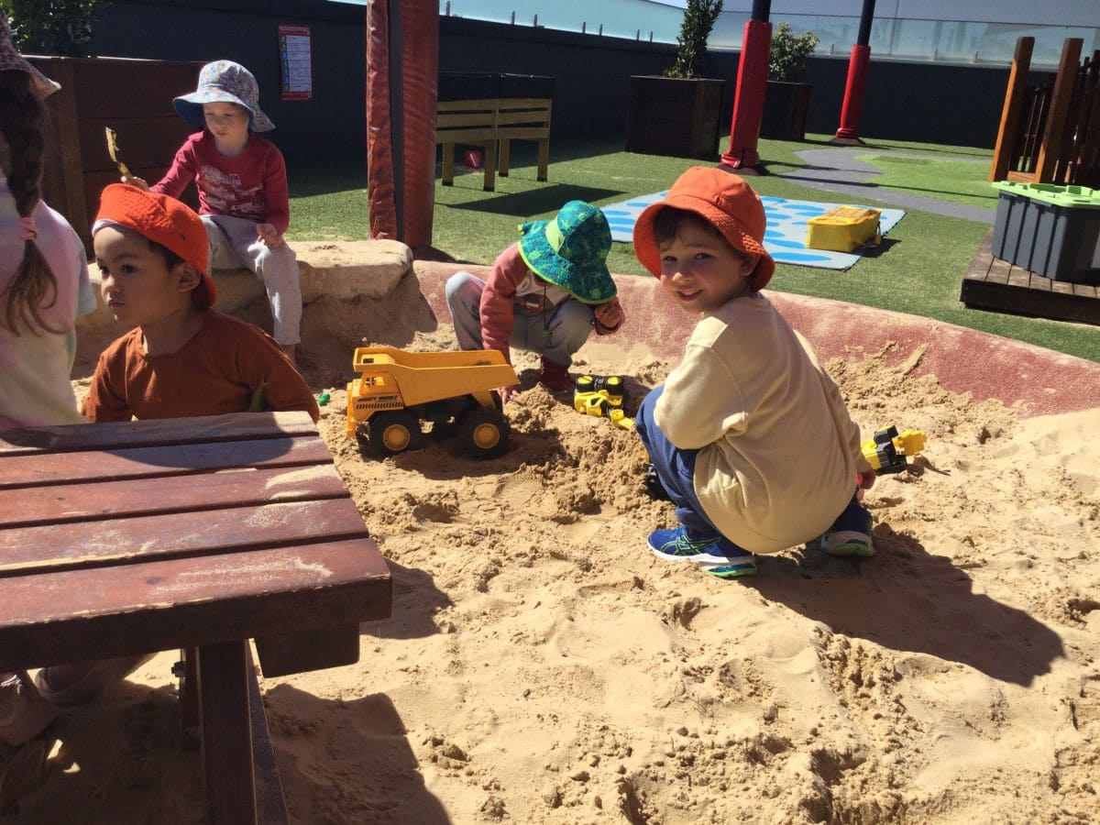

Slide 4
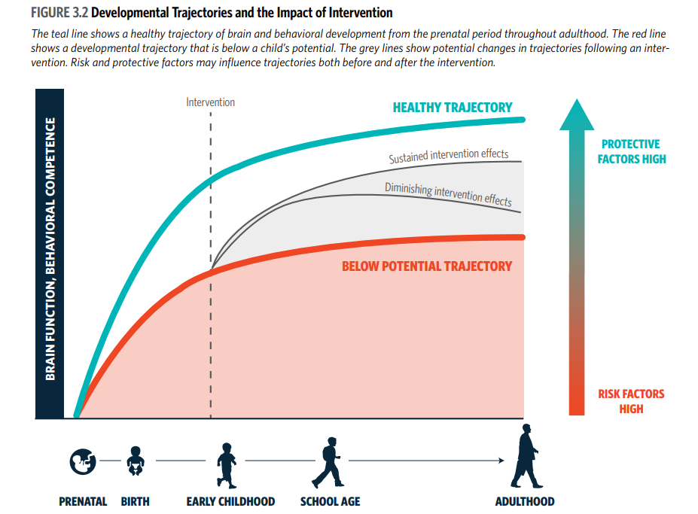

Slide 5
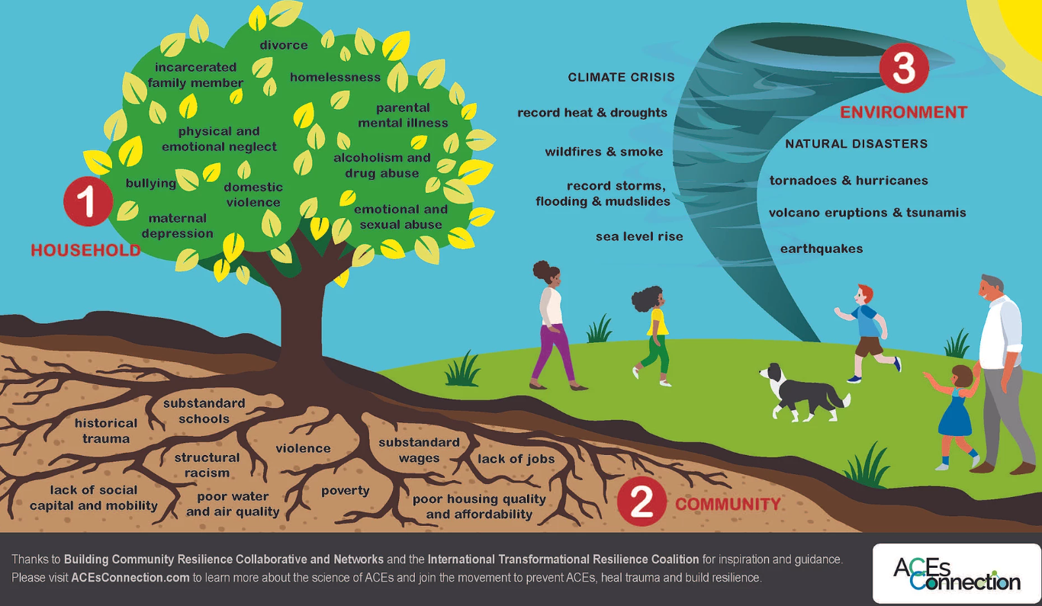
3 Realms of ACES
Notes:
The Pair of ACEs Tree indicating multiple types of ACEs and the relationship to adverse community environments. Ellis, W., Dietz, W. (2017) A New Framework for Addressing Adverse Childhood and Community Experiences: The Building Community Resilience (BCR) Model. Academic Pediatrics. 17(2017) pp.S86-S93. DOI information: https://doi.org/10.1016/j.acap.2016.12.011
New research has expanded the concept of adverse childhood experiences to include the impact of the community on family and child well-being. It’s also broadened the scope of the original ACE study to include people of color and people with lower incomes. Dr. Wendy Ellis of George Washington University coined the term “The Pair of ACEs” to describe how adverse community experiences—such as poor-quality housing, lack of employment, and lack of access to healthcare—are root causes of chronic stress. Such stress leads to chronic mental and physical health problems.

Slide 6
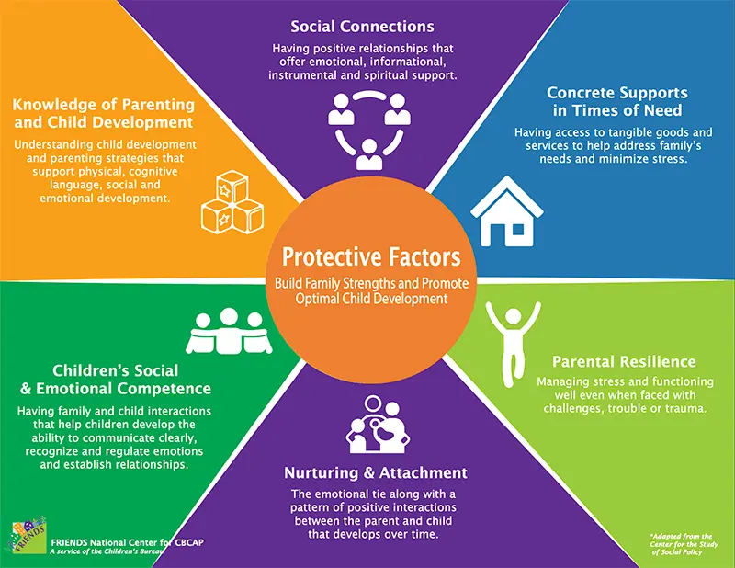

Slide 7


Slide 8
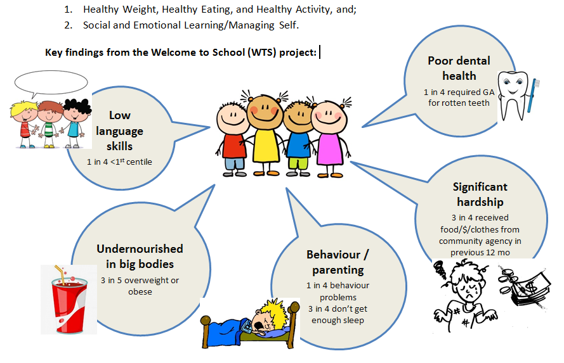
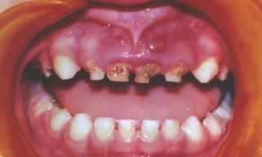
WTS
Notes:
The main results were
Low language skills: 1 in 4 were < 1st centile. This was measured using the CELF-P by a trained paediatric SLT
2/5 children were overweight or obese
Behaviour problems and not enough sleep
1 in 4 children needed a GA for rotten teeth
Significant hardship
33% needed glasses
2 in 5 children: poor impulse control

Slide 9
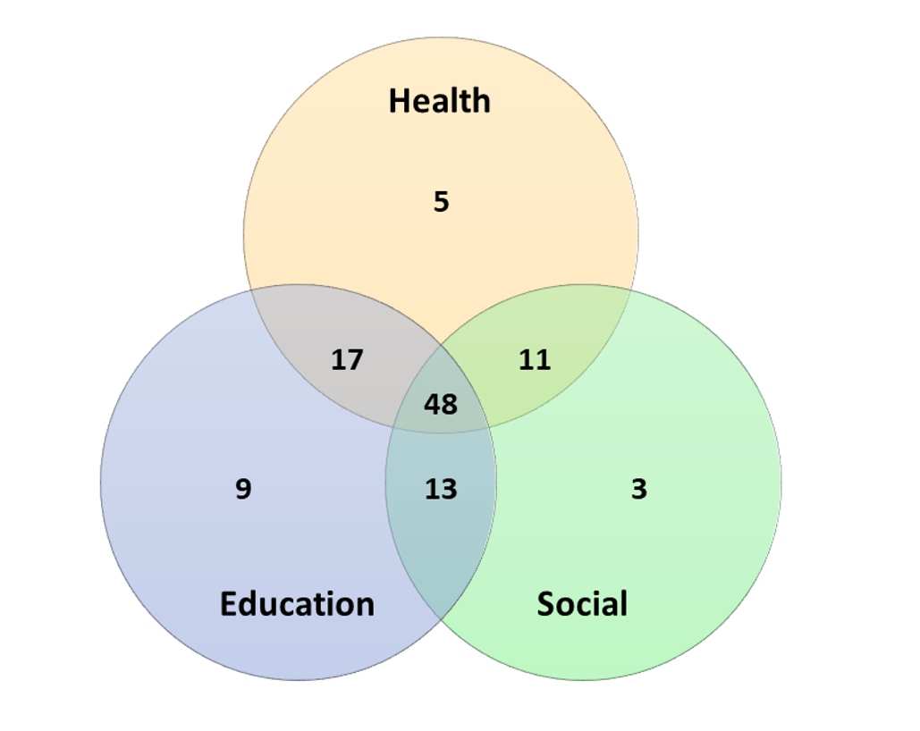
Overlap: health, education, and social needs

Slide 10
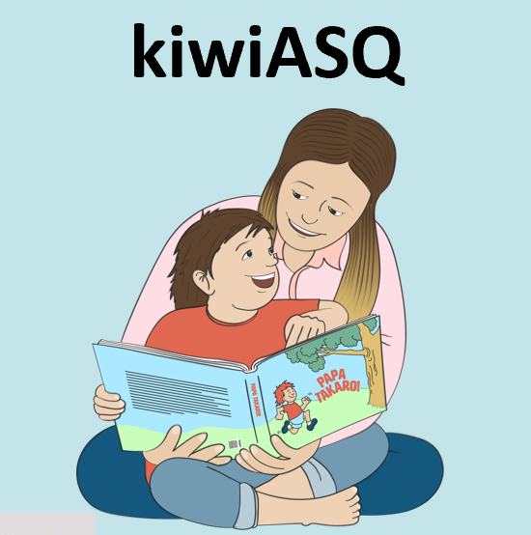
Notes:
And this is the psycho part of the ‘bio-psycho-social’ experience – thoughts that disappear. – go blank!
There is a hostile take over of the conscious brain by powerful negative emotions.
There is a “hijacking of the thinking brain.”
As Daniel Hughes says – these children have flipped their lid. They go from Wizard to Lizard.
They have literally lost the use (temporarily) of their pre-frontal cortex.
Tell story - The boy and he smell of the green grass…Waikowhai
It’s not their fault.
Its not just a matter of doing what’s right.
“It is brain not blame”.

Slide 11
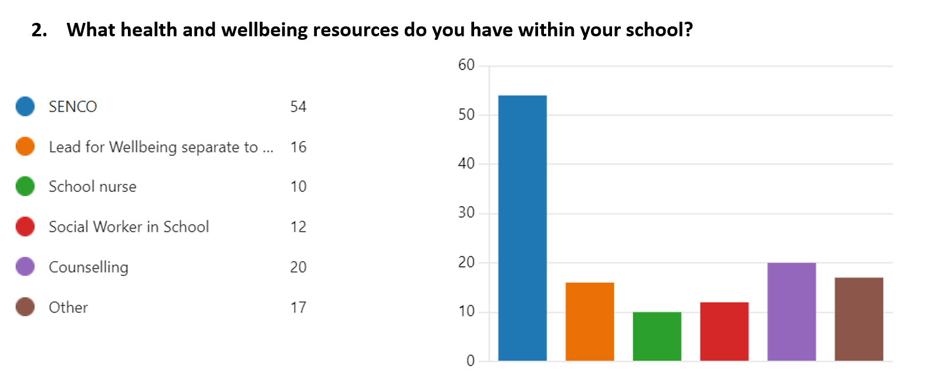
HeEd Collaboration

Slide 12
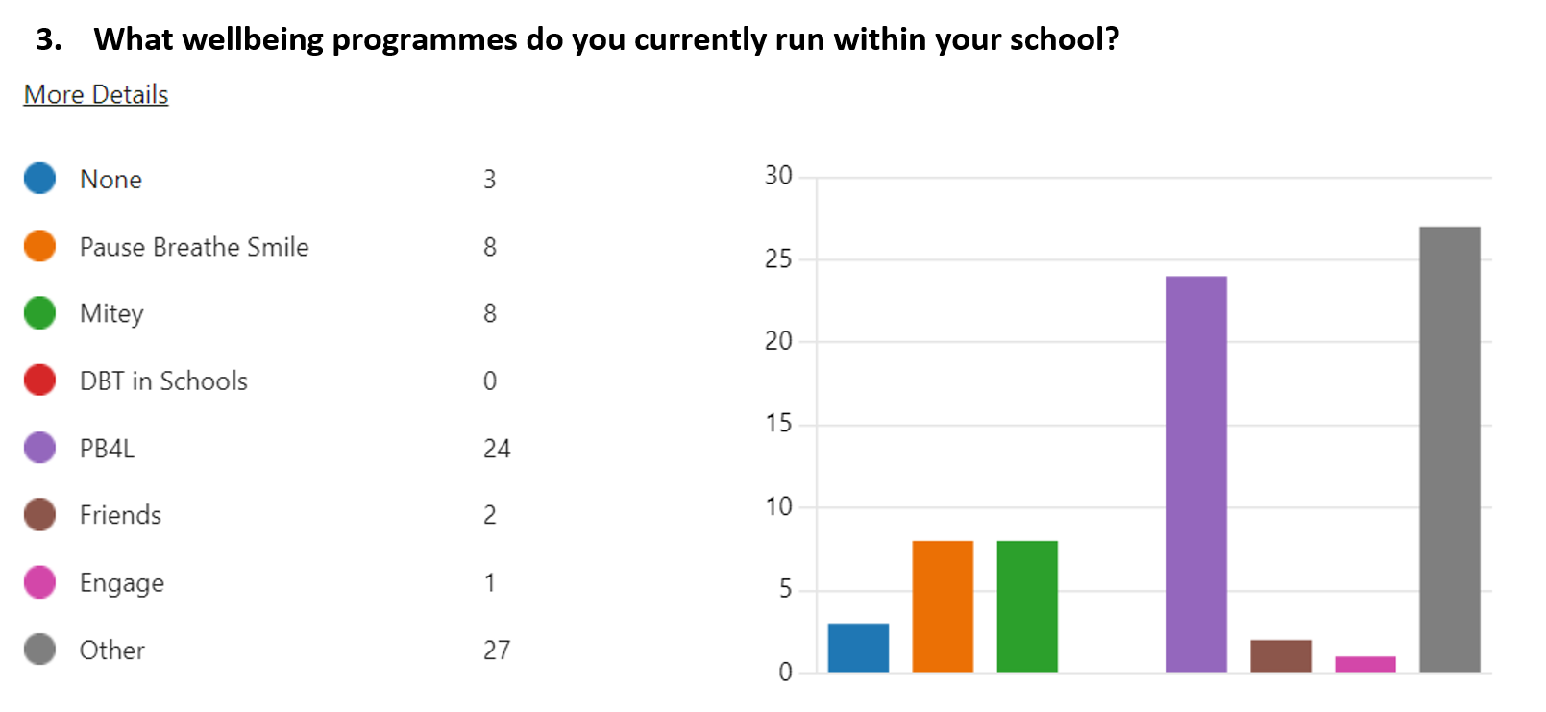

Slide 13
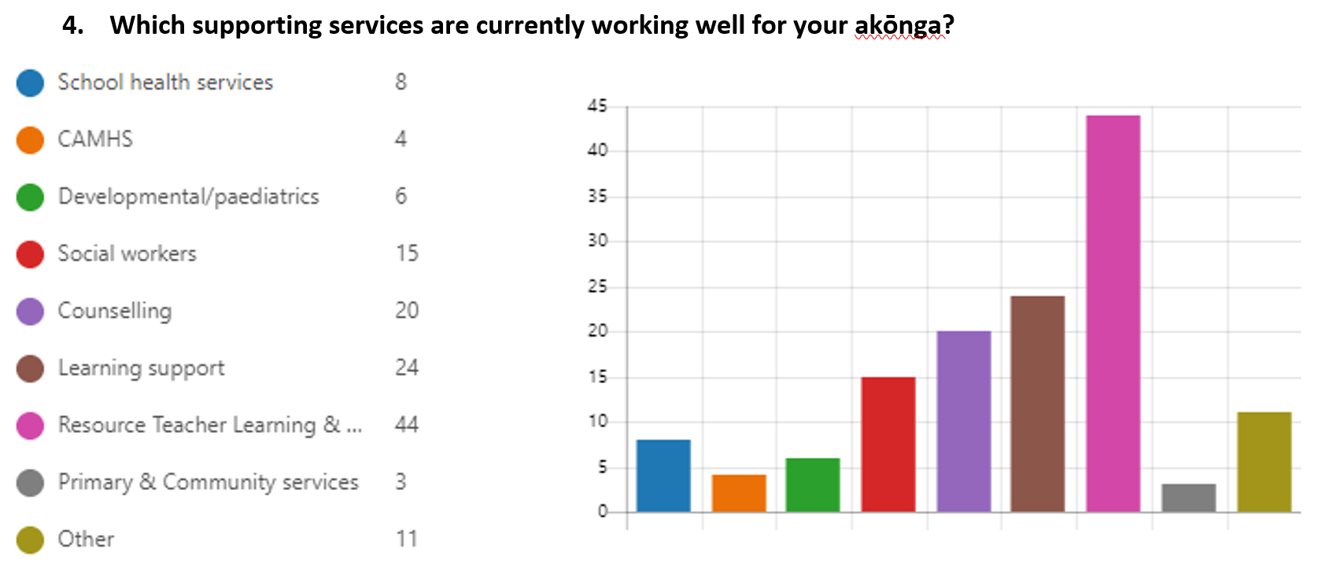

Slide 14
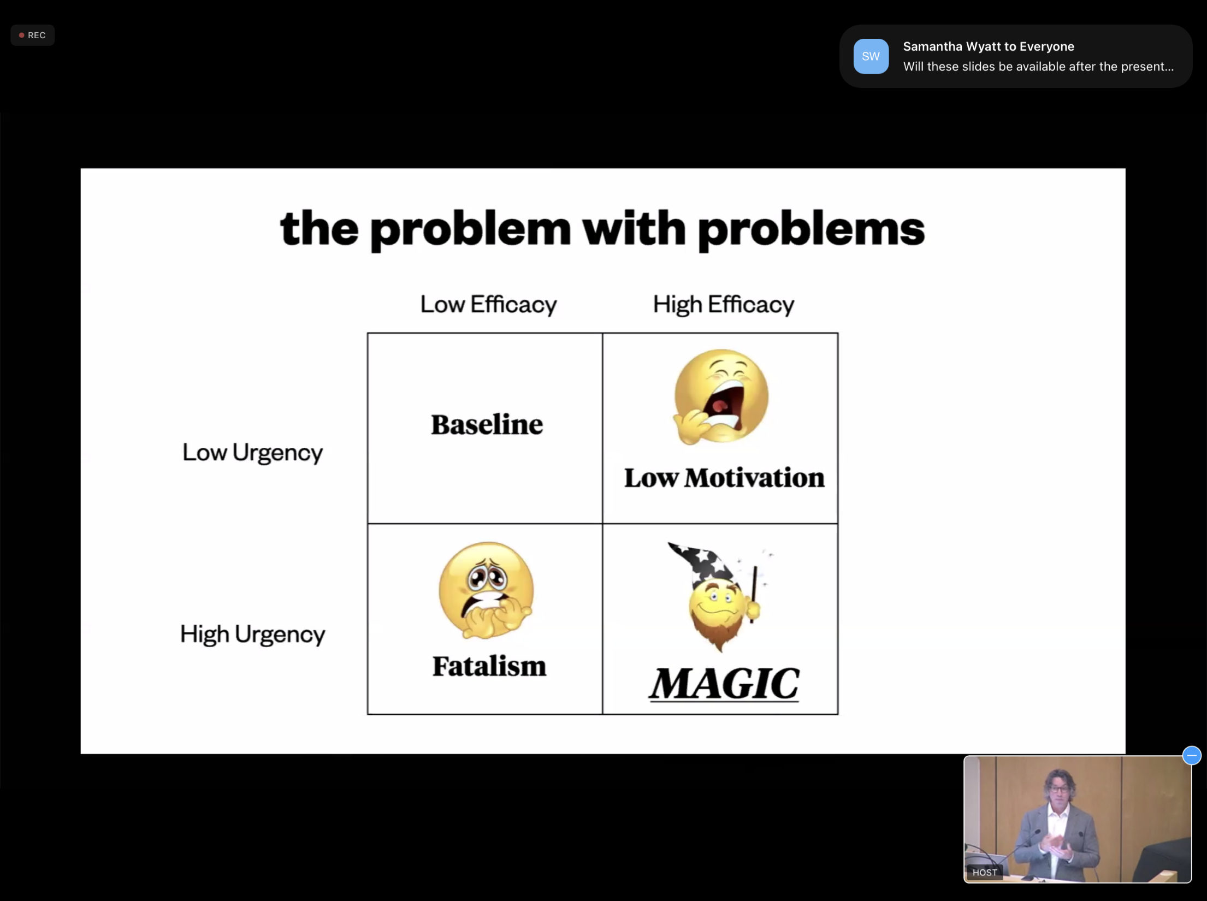

Slide 15
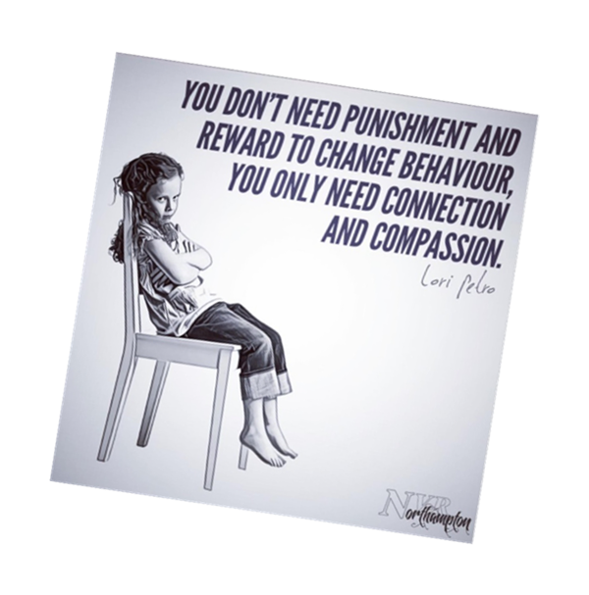

Notes:
“Every kids deserves a champion; an adult who will never give up on them”
As you can see – there are no programmes that make the difference – it is you.

Slide 16
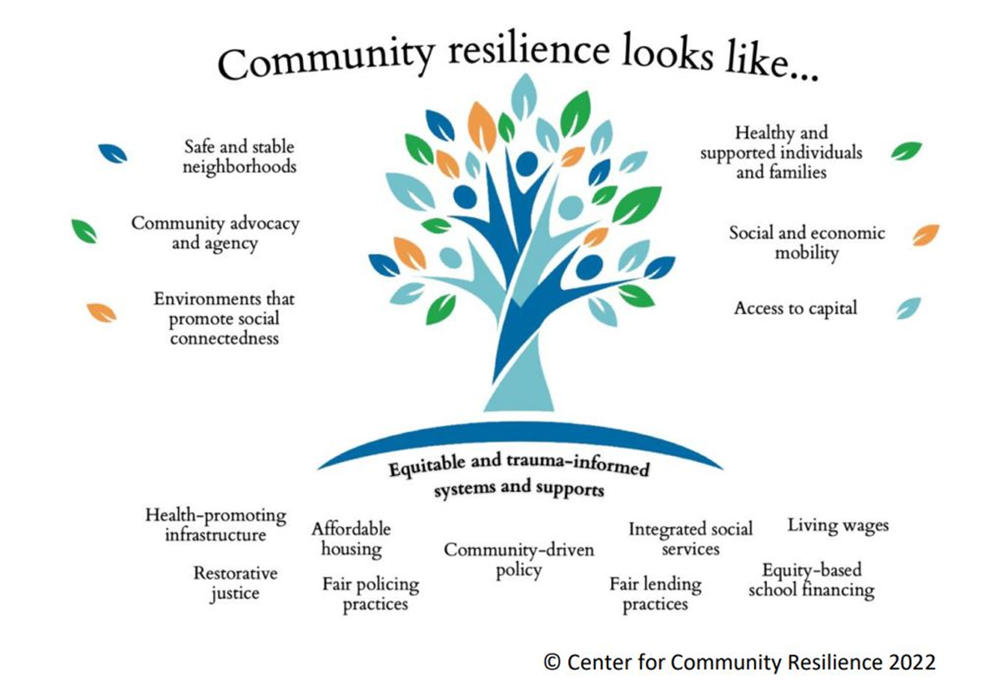

Slide 18

Te Mātaiaho –refreshed NZ curriculum
Currently in draft
Due for final publication in September 2023
Te Mātaiaho | Curriculum Refresh (education.govt.nz)
As part of Te Mātaiaho – Mātaitipu : the educational vision for young people, as conceived by young people

Slide 19
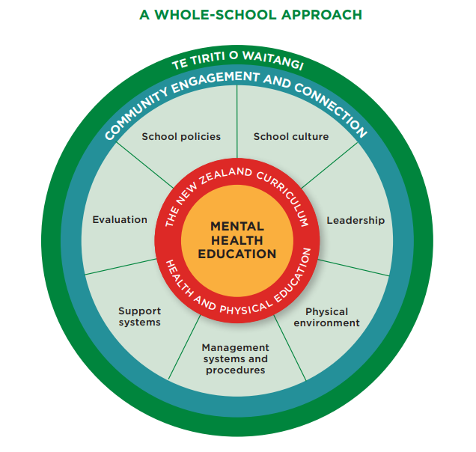
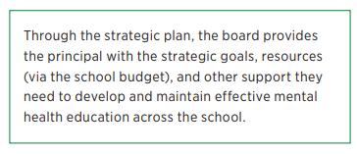
Mental Health Guidelines
Mental health education: A guide for teachers, leaders and school boards | Health & PE · TKI
Whole of school approach for supporting Mental Health

Slide 20
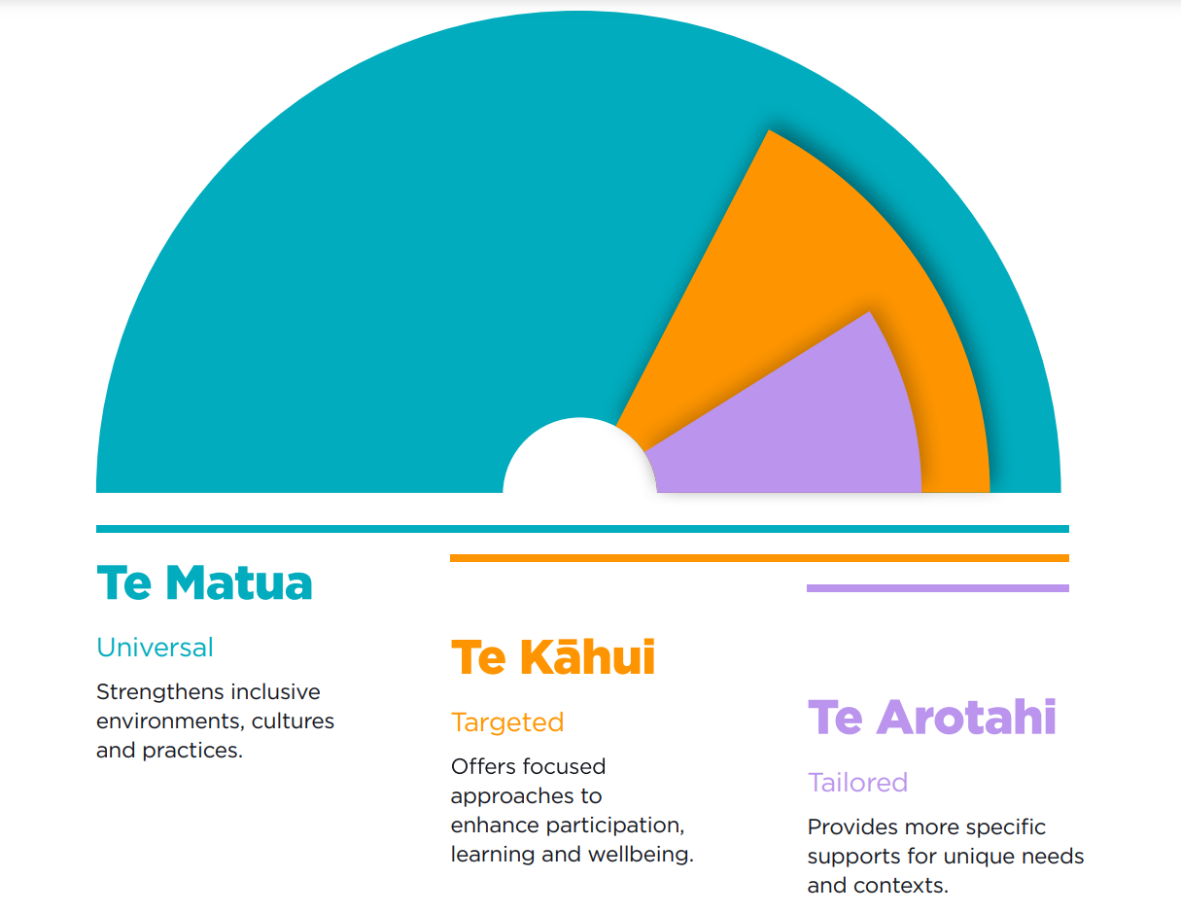
Te Tūāpapa o He Pikorua

Slide 23
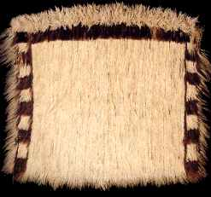
Whakatauki
E hara taku toa
I te toa taku tahi
Engari taku toa
He toa taki tini
Our strength is not ours alone,
but that of our community

