Slide 1


Rebounding from Adversity:
Navigating Life's Challenges and Building a Supportive Community
Lawrence Lotze

Slide 2
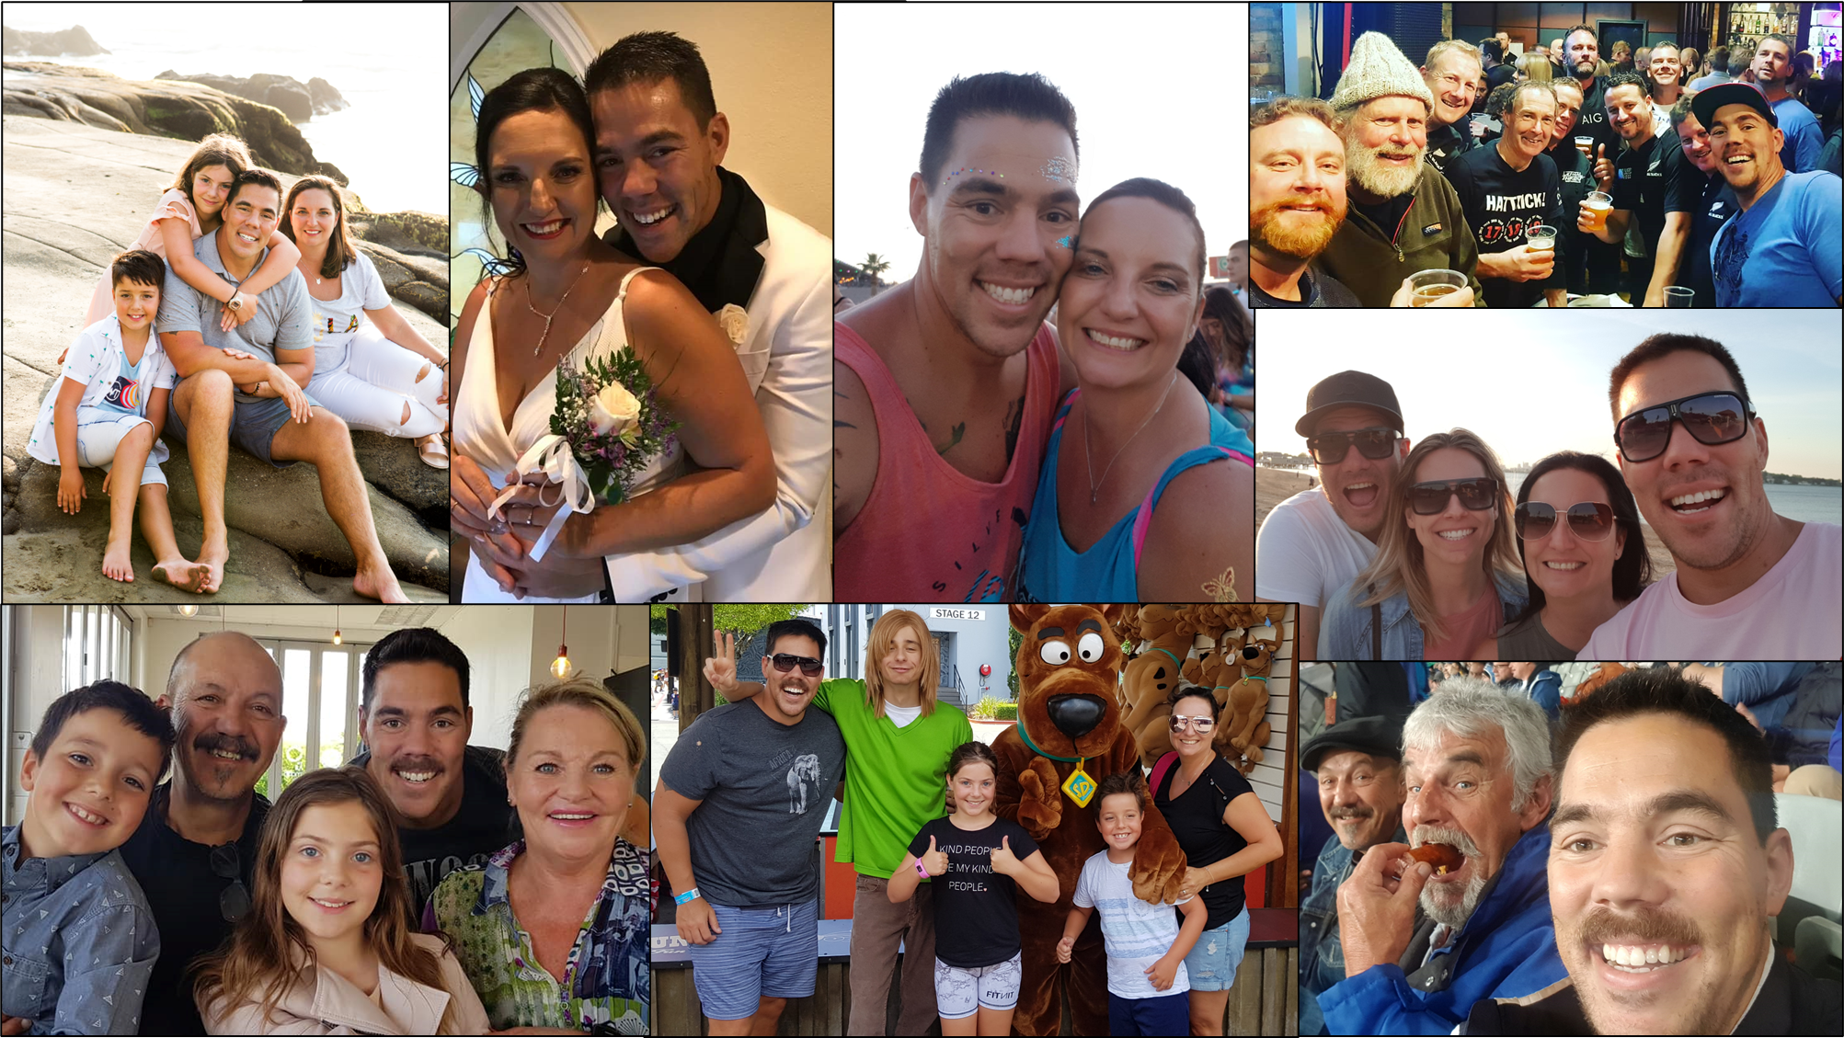

Slide 3
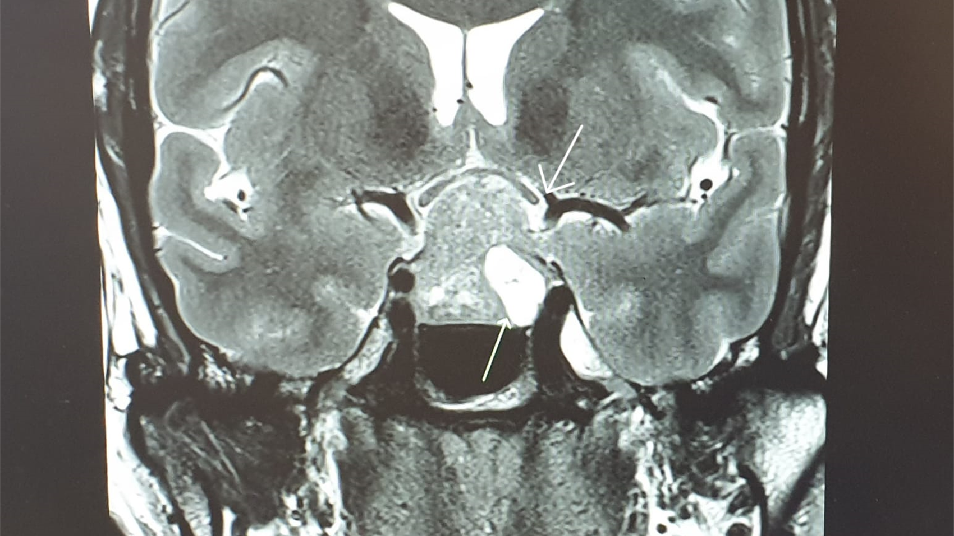

Slide 4


Slide 5
"From arrogance to humility, I now give back to the community with compassion."

Slide 6
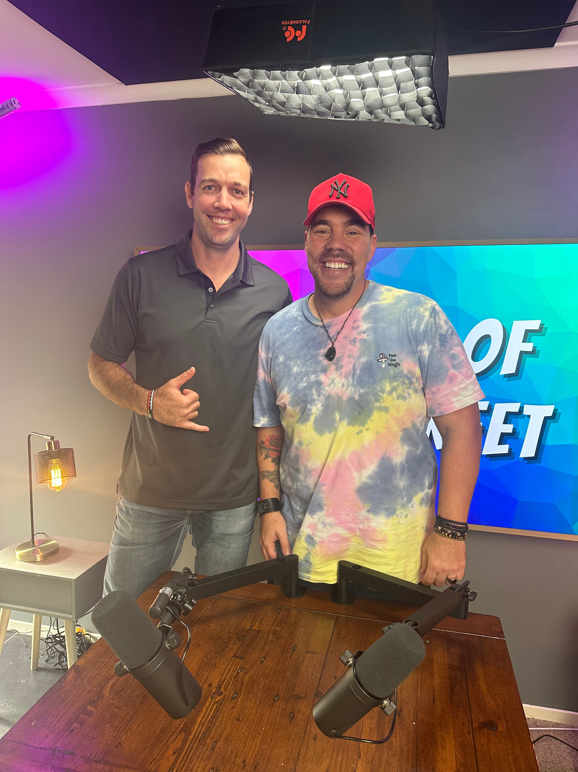
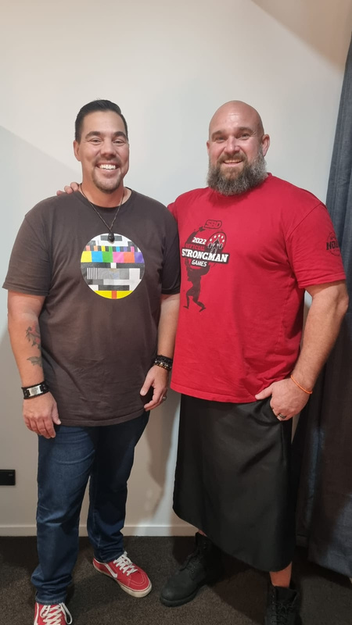


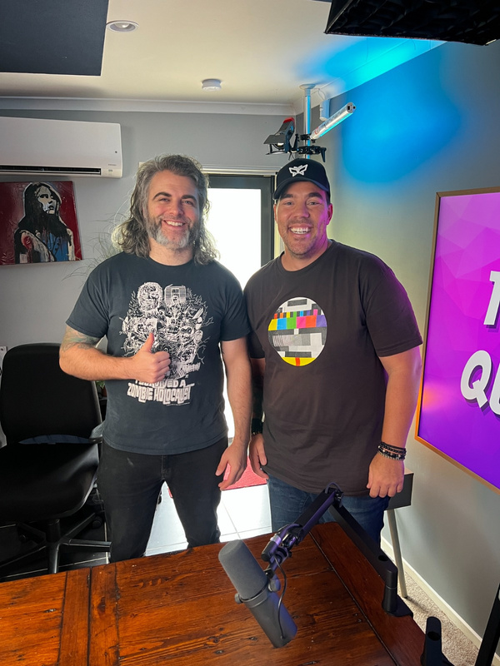
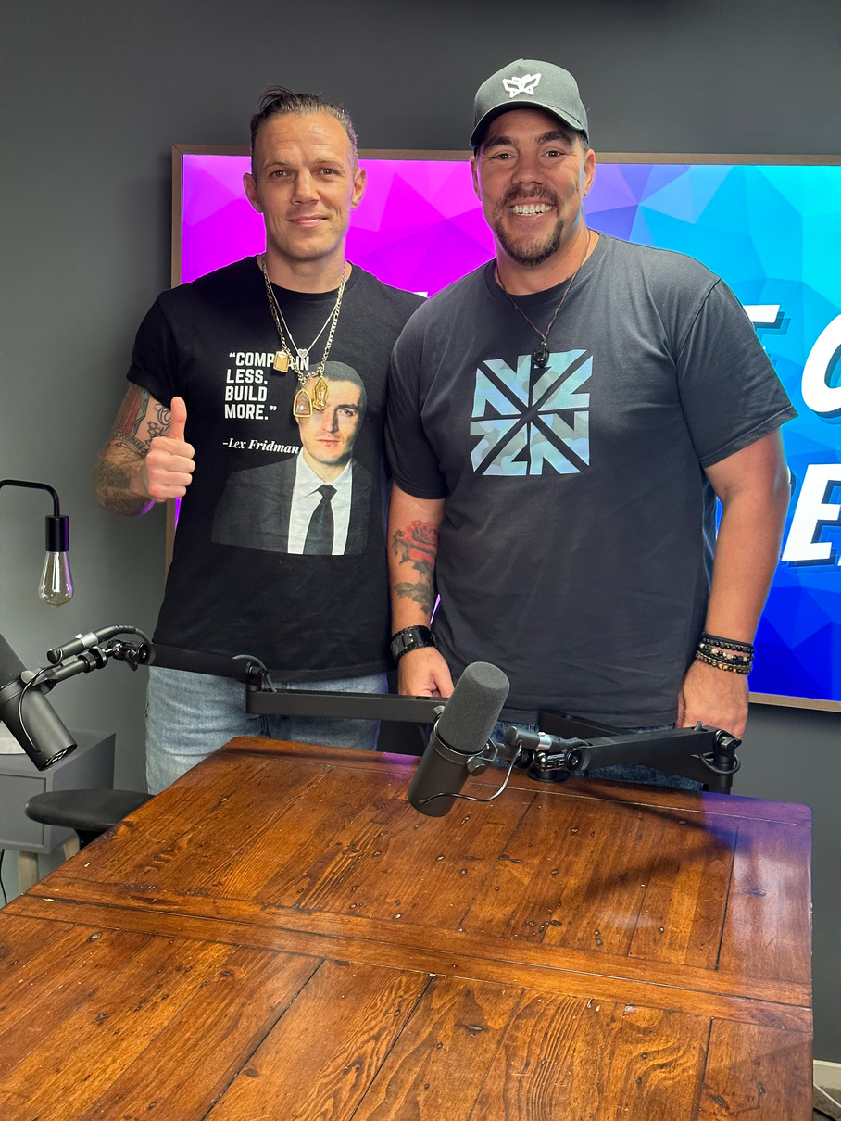

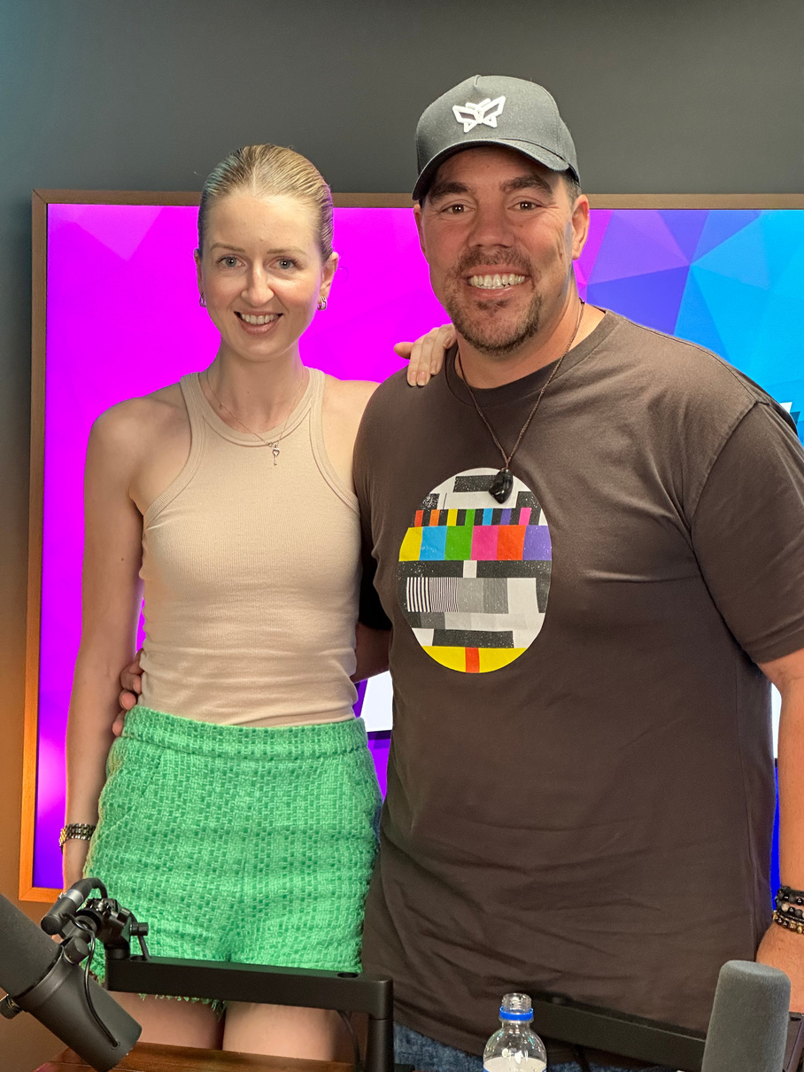
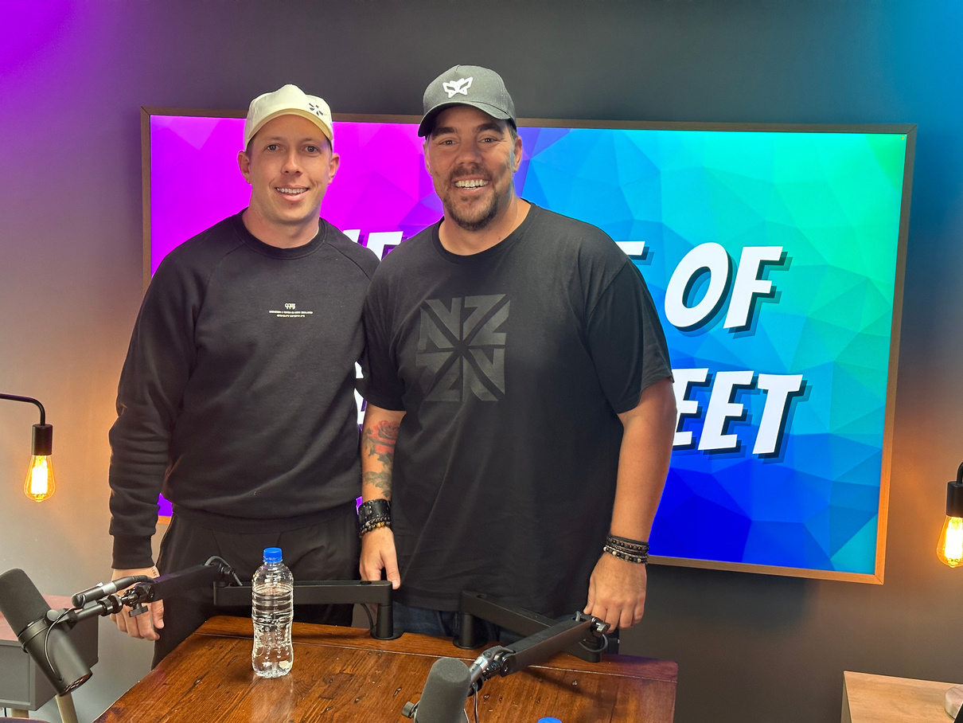


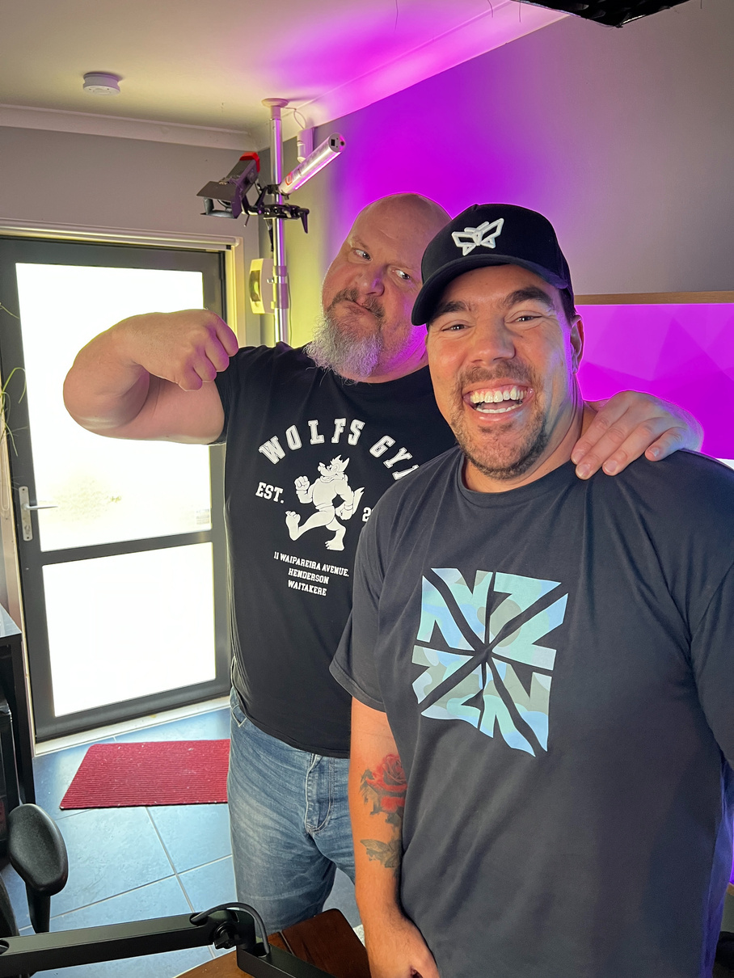
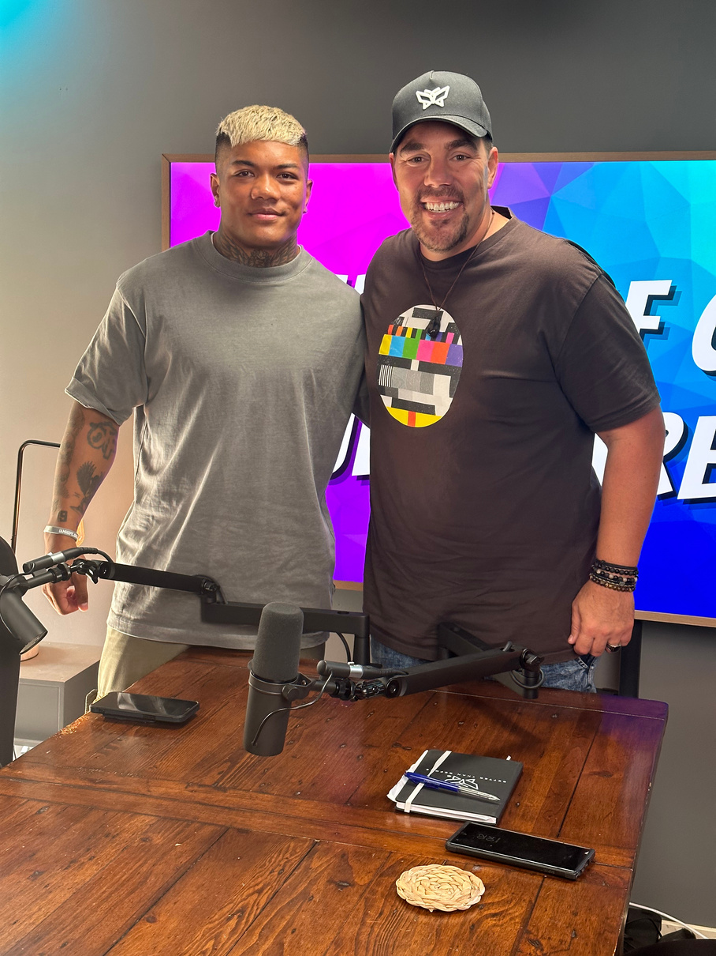



Slide 7
KEY LEARNINGS FROM MY GUESTS
Society's definition of success doesn't define us; it's about finding our own path and what truly brings us happiness.
In the face of adversity and judgment, remember that the power to define ourselves lies within us, not in the opinions of others.
Staying connected to our 'why' or purpose is vital in maintaining our focus and determination, especially during challenging times.
Regrettably, people often pass judgment on others solely based on their differences, without taking the time to understand the person beyond their condition.

Slide 8
KEY LEARNINGS FROM MY GUESTS
Mental health is an important issue that affects individuals across all careers, and seeking support and understanding is crucial.
Having an appetite for learning and personal growth is essential for becoming a better version of ourselves.
Failure is not a dead-end but rather an opportunity for growth and learning along the path to success.
Understanding our unique contributions to the world can be a powerful motivator to make a positive difference in society

Slide 9

Embracing Happiness
And Inner Transformation

Slide 10

Favorite quote from James Patterson
“Imagine life is a game in which you are juggling five balls.1. Work, 2. Family, 3. Health, 4. Friends. 5. Integrity. Work is a rubber ball. If you drop it, it will bounce back. The other four balls are made of glass”

