Slide 1
The NATINA Journey: from trauma to healing & hope.
Frian Wadia MNZM
9th August 2023

Slide 2
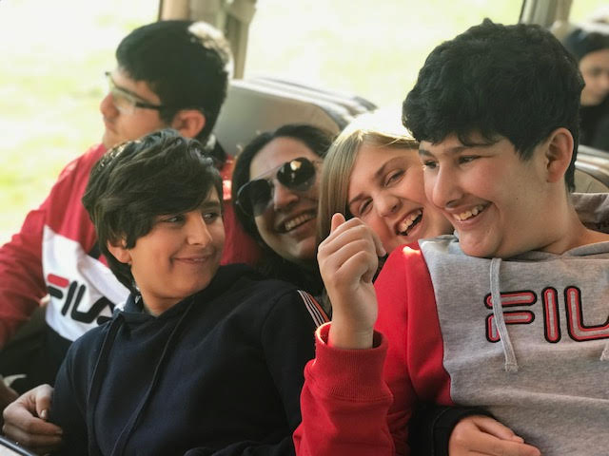
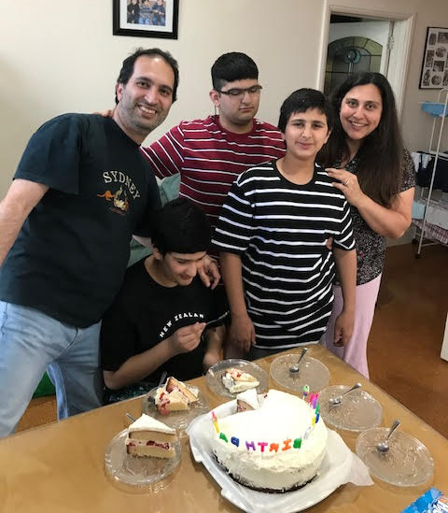
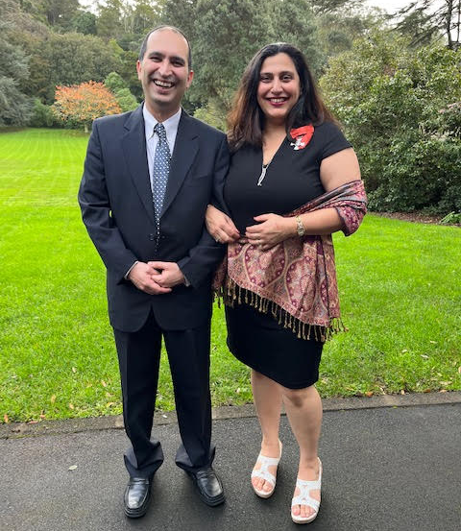
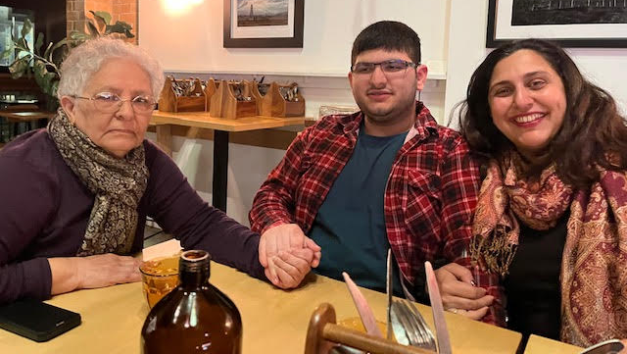
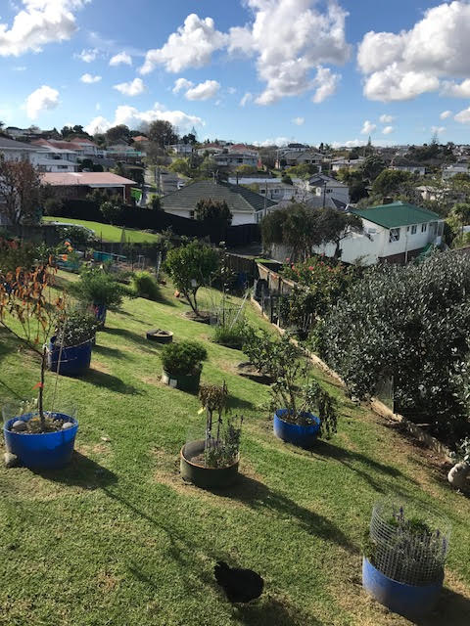
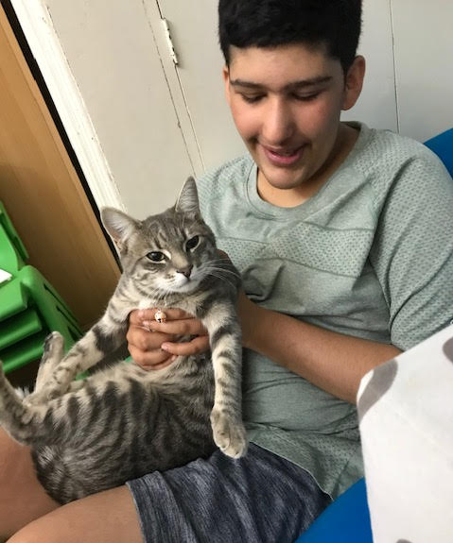
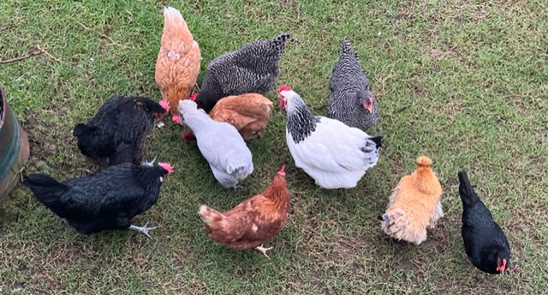
Who am I?
My why…

Slide 3
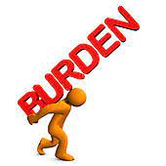
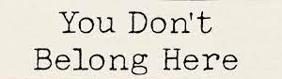
2016
2018

Slide 4
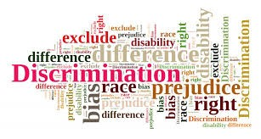
Discrimination
Rejection & exclusions
Unfair punitive measures
Bullying
Unmet needs
Sense of worthlessness
Lack of belonging
Behaviour modification
Lack of adaptations & demands for conformity

Slide 5
WE DON’T BELONG

Slide 6
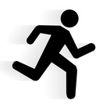
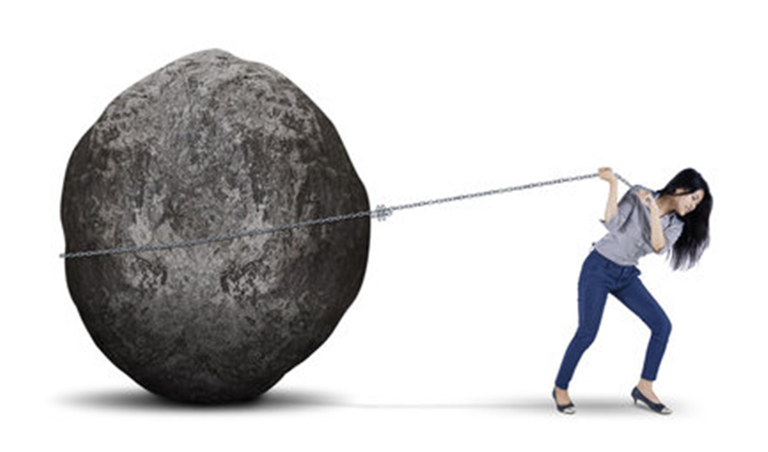
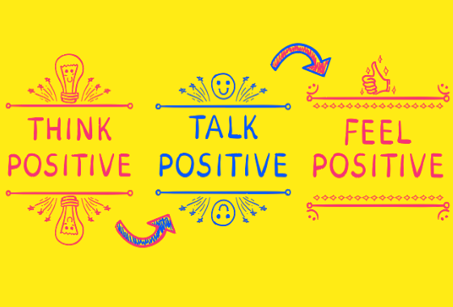
What did I do?

Slide 7
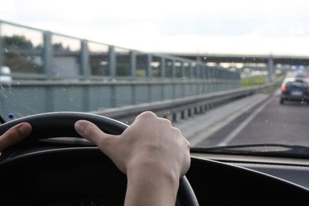

Slide 8
Signs of depression?
Teary eyed constantly
Very emotional
Ruminating over what happened
Stopped smiling
No joy in anything
Butterflies in tummy
High alert
Fearful and scared
Sense of shame and worthlessness

Slide 9
….or is it trauma?
Gabor Mate “Trauma Is Not What Happens to You, It Is What Happens Inside You”
The Wisdom of Trauma - “Trauma is the invisible force that shapes our lives. It shapes the way we live, the way we love and the way we make sense of the world. It is the root of our deepest wounds”.

Slide 11
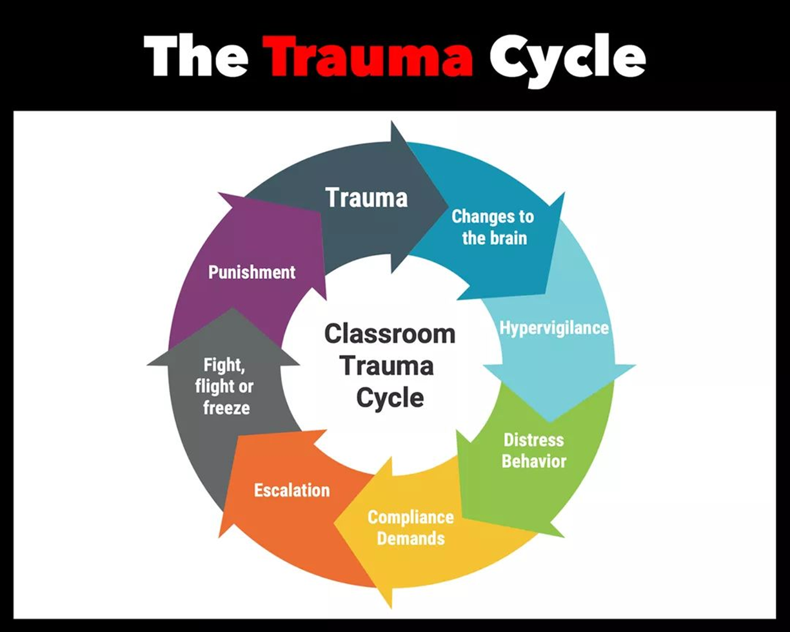

Slide 12
If this is me, … then what about the children?!

Slide 13
Kathryn Berkett – NZ facilitator and researcher, with a series of podcasts and Red brain Green brain video
Dr. Lori Desautels – website Revelations in Education and author of Connections over Compliance and Intentional Neuroplasticity
Dr. Mona Delahooke – Author of Beyond Behaviours and Brain Body Parenting
Dr. Bruce Perry – Child Trauma Academy website with articles and research on child development and trauma
Dr. Dan Siegel – author of Parenting from Inside Out and The Whole Brain Child. Famous for the Flipping the Lid Model of Brain concept
Bessel van der Kolk – author of The Body Keeps The Score
Dr. Stephen Porges – The Pocket Guide to the Polyvagal Theory: The Transformative Power of Feeling Safe, and Polyvagal Safety: Attachment, Communication, Self-Regulation (2021).

Slide 14
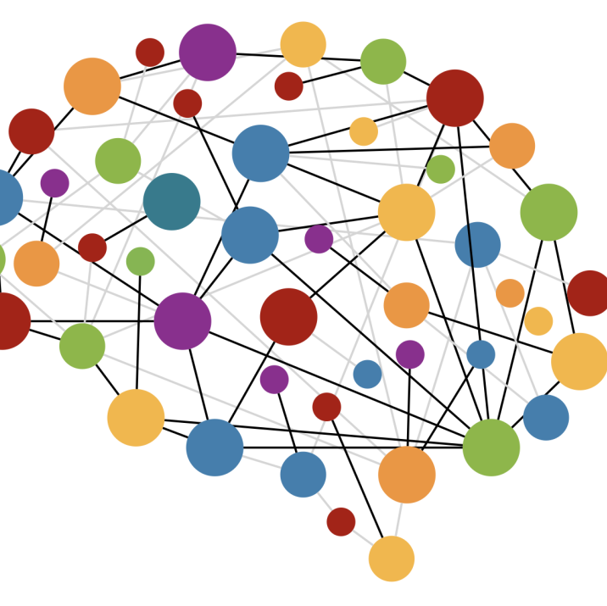
What can I do to change things?
Health
Te Pou website
MOE
Education networks
Parents networks
Disabled people

Slide 15
April 2021 – started monthly hui
Continued korero with MOE
Sharing of information & learning opportunities
Considering international research
Focusing on bicultural lens & Aotearoa context
Looking at ways to influence
Sharing of resources
2022 decided to start up own organisation
Collated material for a website
Supported each other

Slide 16
Why do we need neuroscience and trauma informed approaches in communities, schools and educational spaces?
To uphold mana rights and equity for all.
To understand the impact of adverse life experiences.
To promote individual and collective community resilience
To educate the educators
To shift community mindsets
To create sense of safety and belonging
To improve collective health and social outcomes

Slide 17
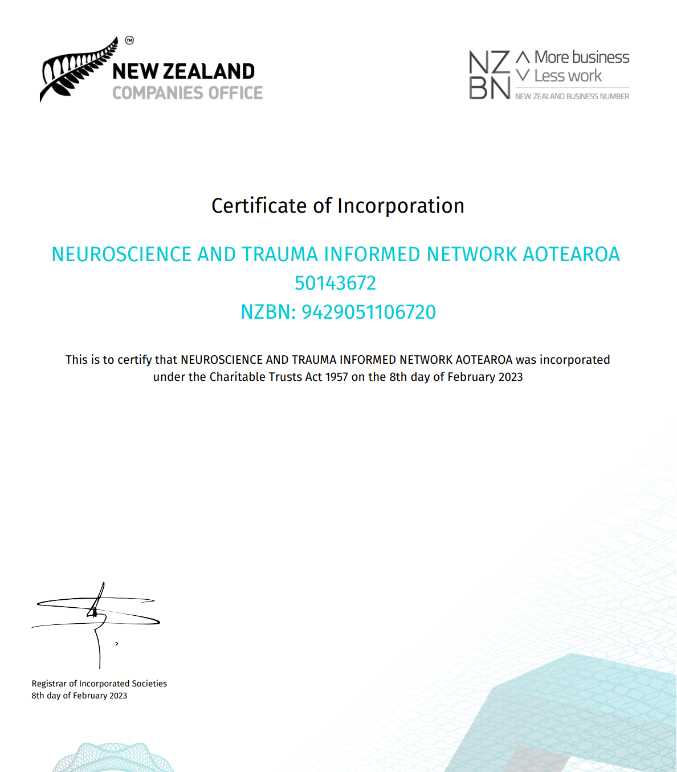
7th Feb 2023 – established trust
CC61096
Neuroscience And Trauma Informed Network Aotearoa (NATINA)

Slide 18
Our Vision: (Where we are headed)
To create inclusive, safe, trauma aware schools and communities so that every ākonga belongs, learns and thrives.
Mission (What we do & how we will get there)
Promote, support, educate and advocate for neuroscience and trauma informed approaches to create safe, inclusive, holistic and thriving learning spaces/communities, by offering well-researched culturally appropriate information, professional development, influencing policy development and creating resources.
Values & Principles (Our non-negotiables, what we will live by)
The work of the network will uphold and promote
Te tiriti o Waitangi;
the articles of the UNCRPD, UNCRC and UNDRIP;
The Enabling Good Lives principles;
Me tiaki te mana o te Tamaiti - To protect the mana of the Child
compassionate and relationship based approaches;
Non punitive, restorative and supportive approaches embedded across whole schools and local communities.

Slide 19
CHARITABLE PURPOSES OF THE TRUST (as stated within our Trust Deed):
The purpose of the NATINA Trust is to promote neuroscience and trauma informed approaches that support and enhance the education and wellbeing of disadvantaged and trauma affected children in educational and other settings in Aotearoa New Zealand. We intend to focus on the following key areas:
Promotion/Education/Advocacy about neuroscience and trauma informed approaches in education aimed at creating safe, inclusive, holistic and thriving learning spaces/communities, by offering evidence based, culturally appropriate information, training, policy guidance, dissemination and development of resources;
Impacting Learning and Wellbeing of Children with a particular focus on those at higher risk of being affected by trauma due to ongoing marginalisation and discrimination because of their lived experiences of disability, neurodiversity, gender identity as LGBTQIA+, socioeconomic disadvantage, and Māori and Pasifika who experience systemic racism that contributes to intergenerational trauma;
Strengthening and Supporting Communities by enhancing the understanding, capacity and effectiveness of the wider communities that work with, and affect educational and wellbeing outcomes for, trauma affected and other marginalised groups stated above in educational and other settings;

Slide 20
What now?
Website development, logo and branding.
Finding the Parallels Project: Te ao Maori & Western Worldview of trauma, healing and neuroscience of learning.
Understanding and Healing Trauma within the Disability Context
Support for mentoring those who wish to start out on their journey of being trauma informed.
Support with PLD for educators and training for whanau community.

Slide 21
To connect or contribute contact:
Frianwadia@natina.co.nz
Mobile: 0272744424

