Slide 1
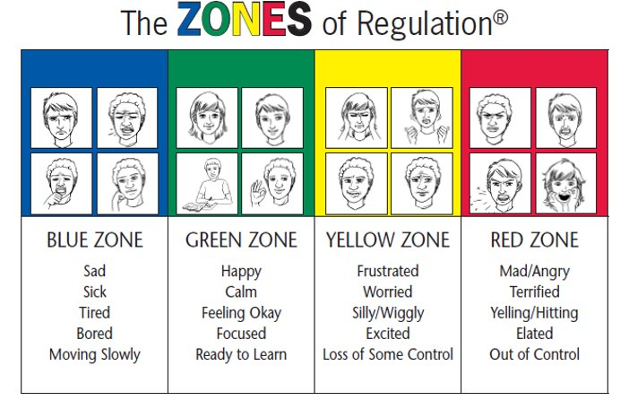
Zones of Regulation: St Mary's Catholic School's Journey
Presented by Michele Hucker (RTLB) and Alisha Hutton (Teacher)
Notes:
Michele:
Kia ora koutou, Ko Michele Hucker tōku ingoa RTLB, and with me this afternoon is Alisha Hutton a Yr 4 teacher and school wellbeing leader at St Mary's Catholic School. We are here today to talk about the Zones of Regulation. A social emotional learning curriculum and regulation programme, that supports student wellbeing.
It is a simple approach to developing self-regulation. I will be giving a brief overview of Zones of Regulation, commonly referred to as ZOR. How it is an effective programme to support students wellbeing by teaching children to self-identify how they're feeling, better understand their emotions, sensory needs and thinking patterns.
Alisha will then share her and St Mary's journey with the Zones of Regulation programme.

Slide 2
ZOR Curriculum
Lessons teach students about how their thinking patterns, internal emotions and sensory needs, can result in them shifting from one zone to another.​
Notes:
Michele
We have seen the negative impact, of the last few years, on child well-being and self regulation
Children are struggling to manage their feelings and mental health
Children are requiring additional social, emotional and behavioural support
All the different ways children feel and the states of alertness they experience are categorised into four coloured zones. Children who are well regulated are able to be in the appropriate zone at the appropriate time

Slide 3
Delivery
Anyone who works with children.
Age range = all school age students (may require some adaptations).
Children with learning needs may require further differentiation and repetition.
Small groups, one-to-one, or whole class (18 lessons, each 30 – 60 minutes).
Each child makes their own workbook.
Provide plenty of opportunities for generalisation.
Notes:
Michele:
The curriculum is designed for anyone who works with children, including parents, SWIS, TAs/LAs, MOE etc
The programme is for all school age students
It can also be adapted for children who require further differentiation
It is an inclusive programme, that can be implemented with small groups, whole class, or across the whole school.
The lessons encourage children to learn about their own regulation systems and how they can adjust them
The four colours are used to help children verbally and visually identify where they are in any given moment
The Zones of Regulation programme is an empowering tool to build safe, supportive environments that foster learning and well-being for all students

Slide 4
Workshop on our Amygdala
Notes:
Michele:
It was discussed and agreed that I would work alongside Alisha to implement ZOR with her class.
Part of the intervention also included me running an 'Our Amazing Brian" - Amydgala workshop with a group of students, including the 'target' student. This workshop included Karen Young's Hey Warrior book.
The students learnt about their amazing brain and why they sometimes 'flip their lid'. The workshop was successful, with the students engaging with the content.
They were very excited to then present the workshop, with me, to the class. They confidently shared what they had learnt about their amazing brains and amygdala.
Alisha then planned and delivered the first ZOR lesson.

Slide 5
Where to next...
St Mary's Catholic School Ellerslie
Notes:
Michele:
So where to next..... Whole staff PD has been requested in order to filter Zones of Regulation across the school, as part of their school curriculum supporting positive behaviour strategies which are underpinned by PB4L MOE initiative

Slide 6
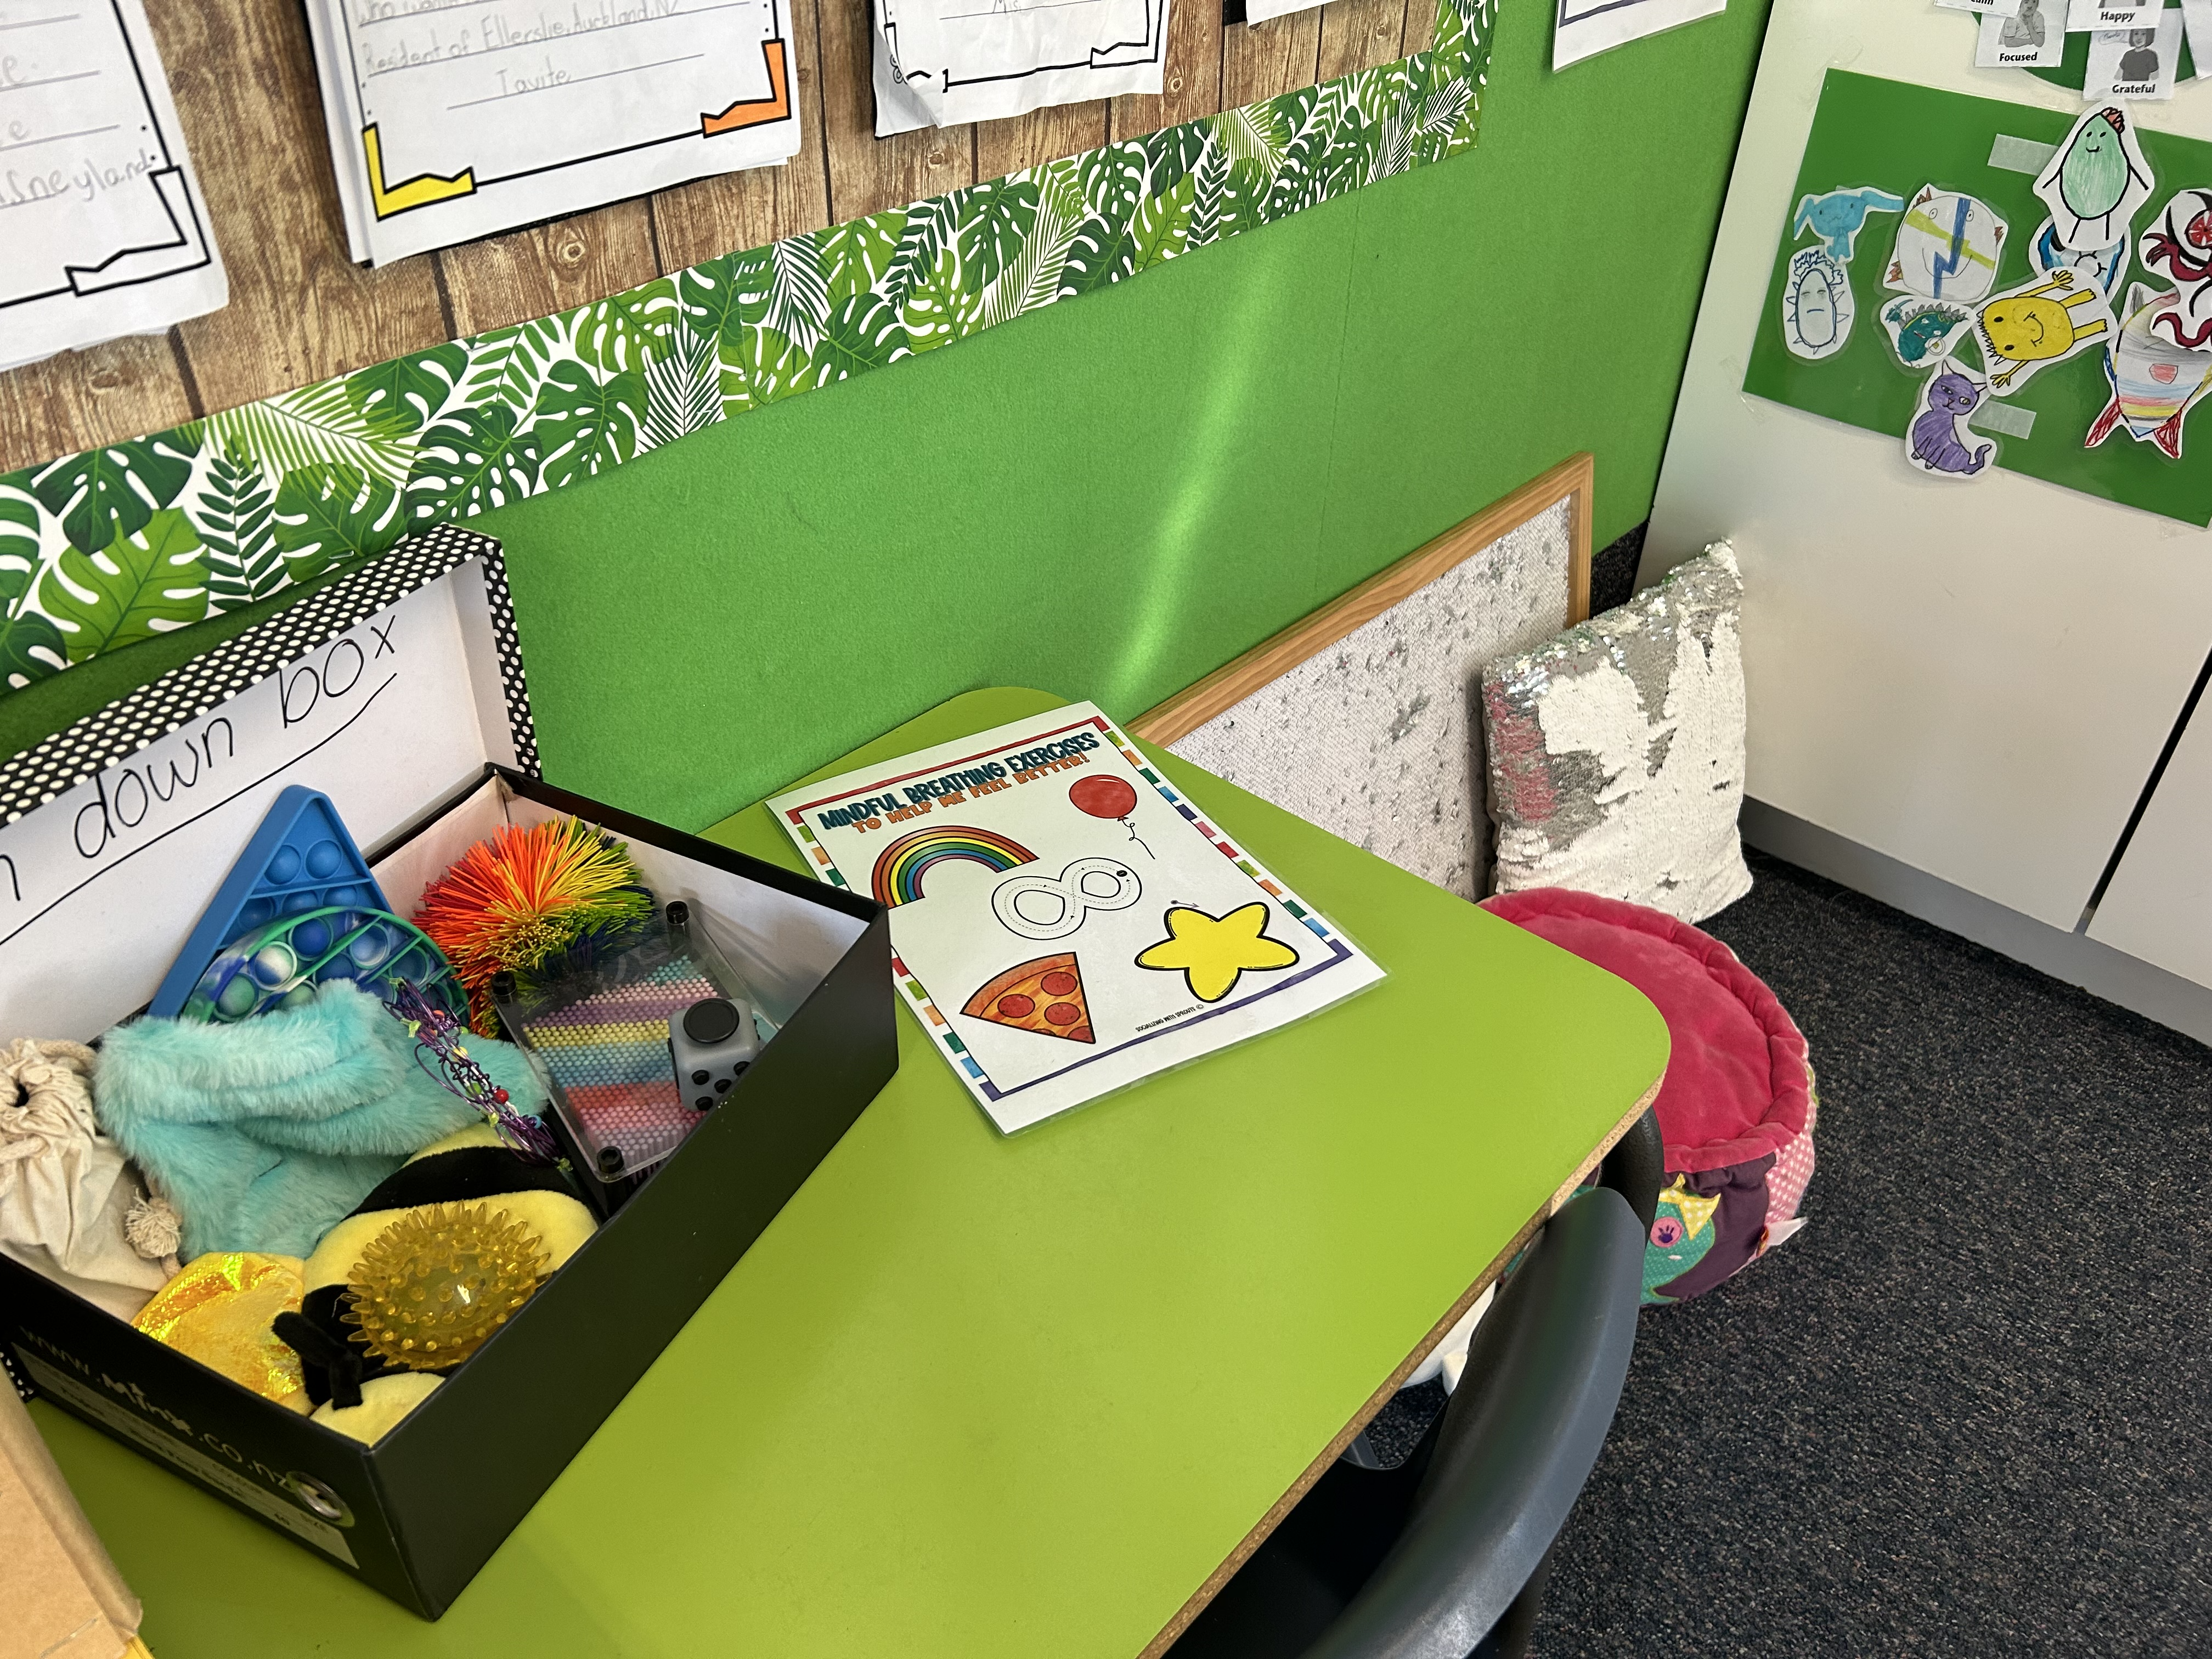
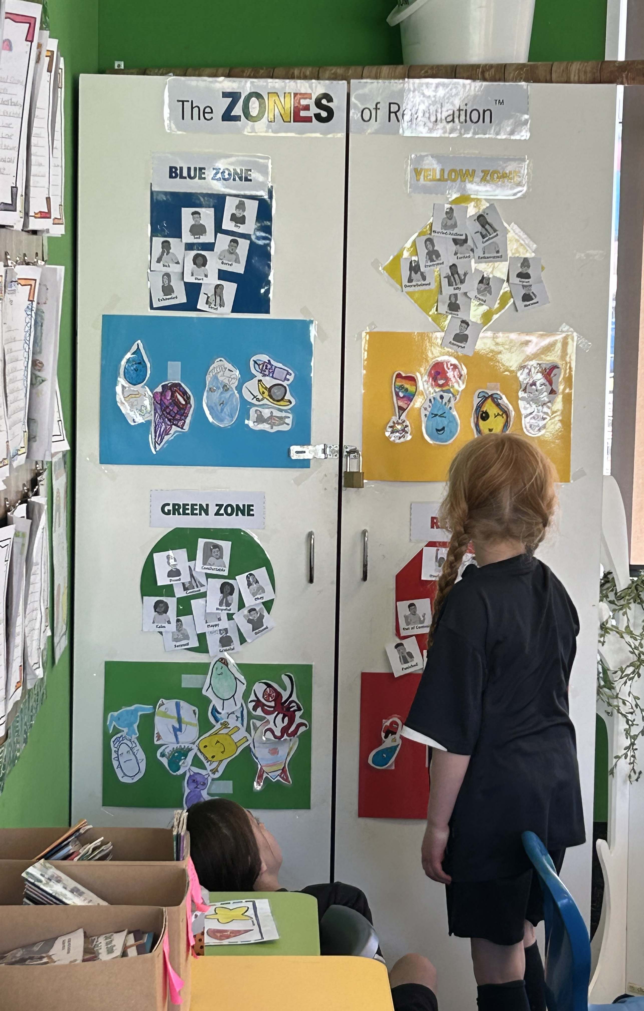
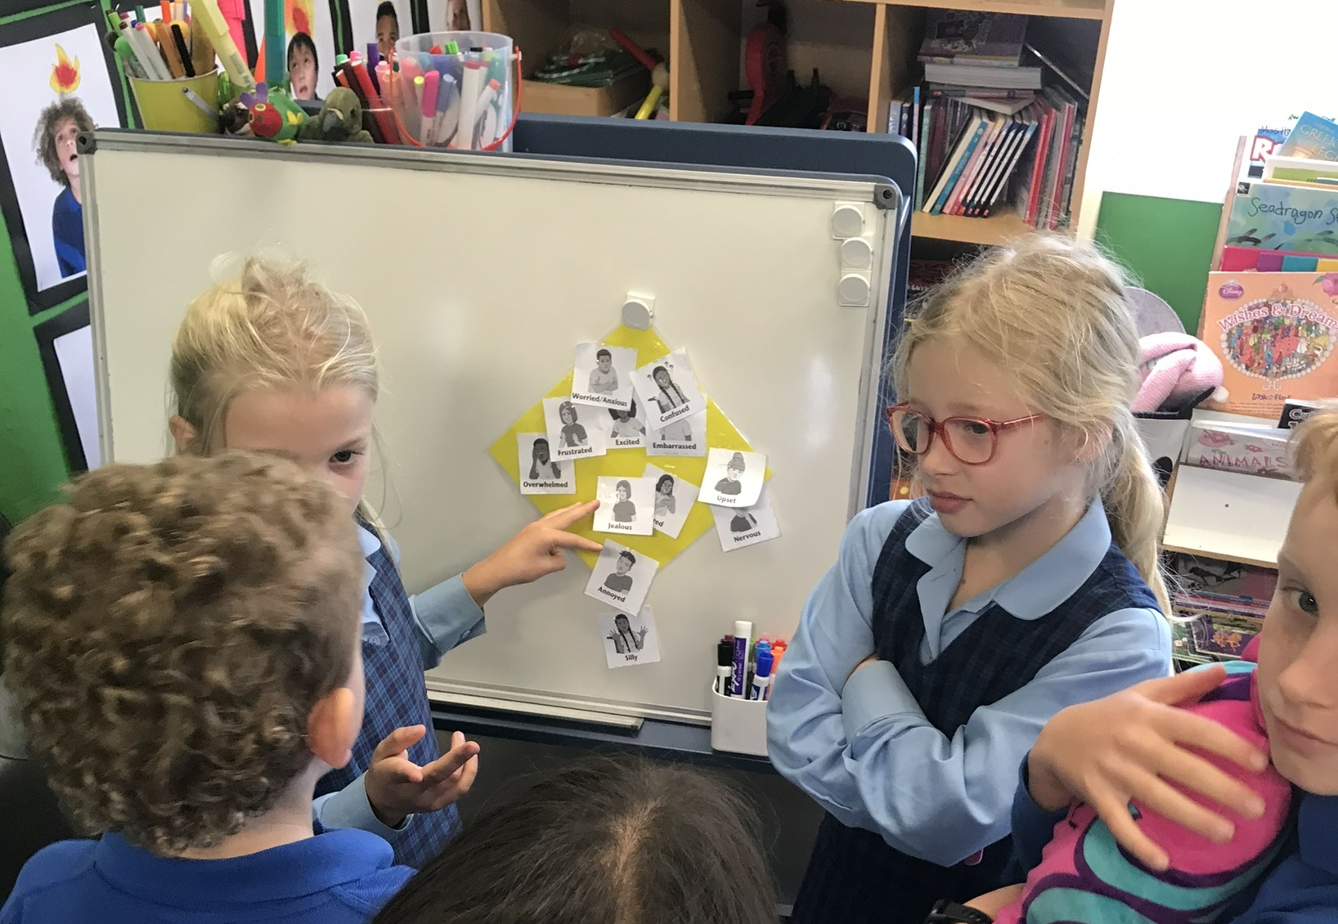
The Zones Journey
Notes:
Alisha:
This process started off as an individual RTLB referral. I did a PD session with Michele to better understand the theory and implementation of ZOR. She unpacked the resources I would need and gave me tips.
Once I got the Zones Curriculum I was blown away by how supported you are as a teacher through the lesson plans. I found it easy to build up my bank of resources as they were all included in the physical book as well as available on a printable link. I introduced the zones to my class through the lesson 1 activities, we went through a range of emotion cards and identified which zone they fit into. The children were able to connect with the emotions as we discussed examples through out the lesson.
My students really connected with the amygdala workshop so we decided to draw our amygdala's for our check in station.
The children immediately began using the physical zones station and zones language. I often over hear students asking their peers "what can we do to get back into the green zone?"
It has allowed my class to give language to their emotions and therefor communicate much more clearly. I'm really looking forward to continuing on the Zones journey as there is so much to unpack and learn and the curriculum makes it SO accessible for all.
I am endeavoring to generalise Zones throughout the day/week by providing plenty of opportunities to revisit, model and coach the students. It is not about being a one off lesson.

Slide 7
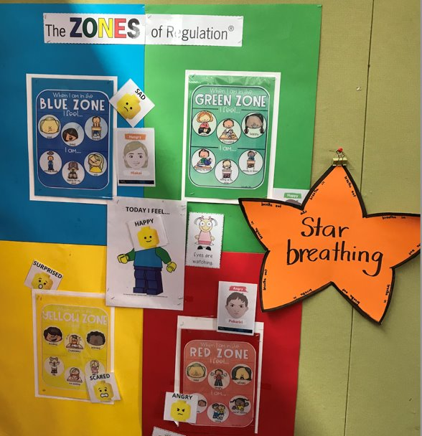
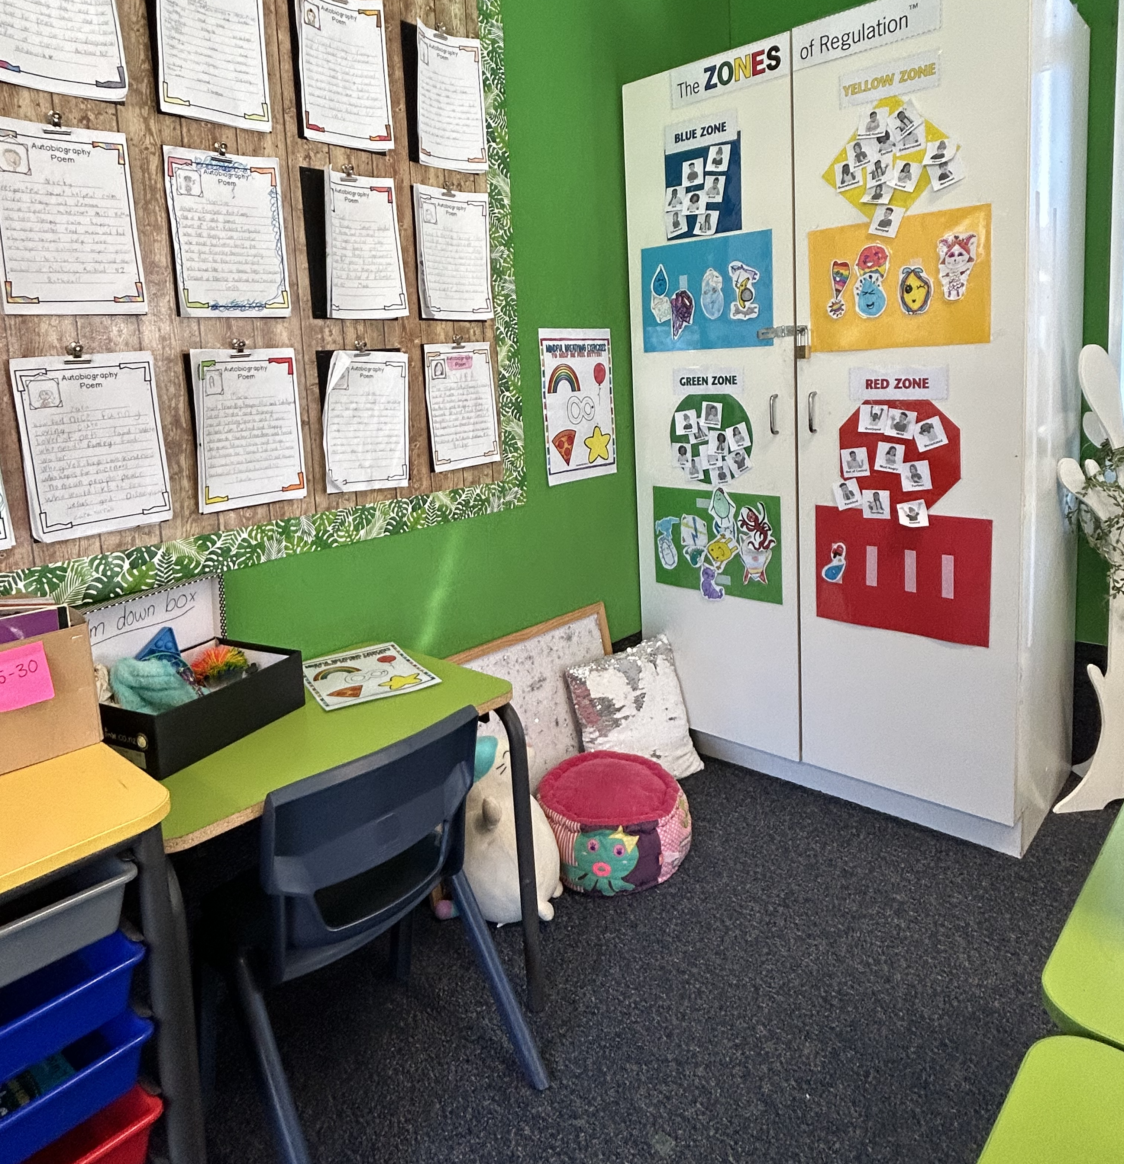
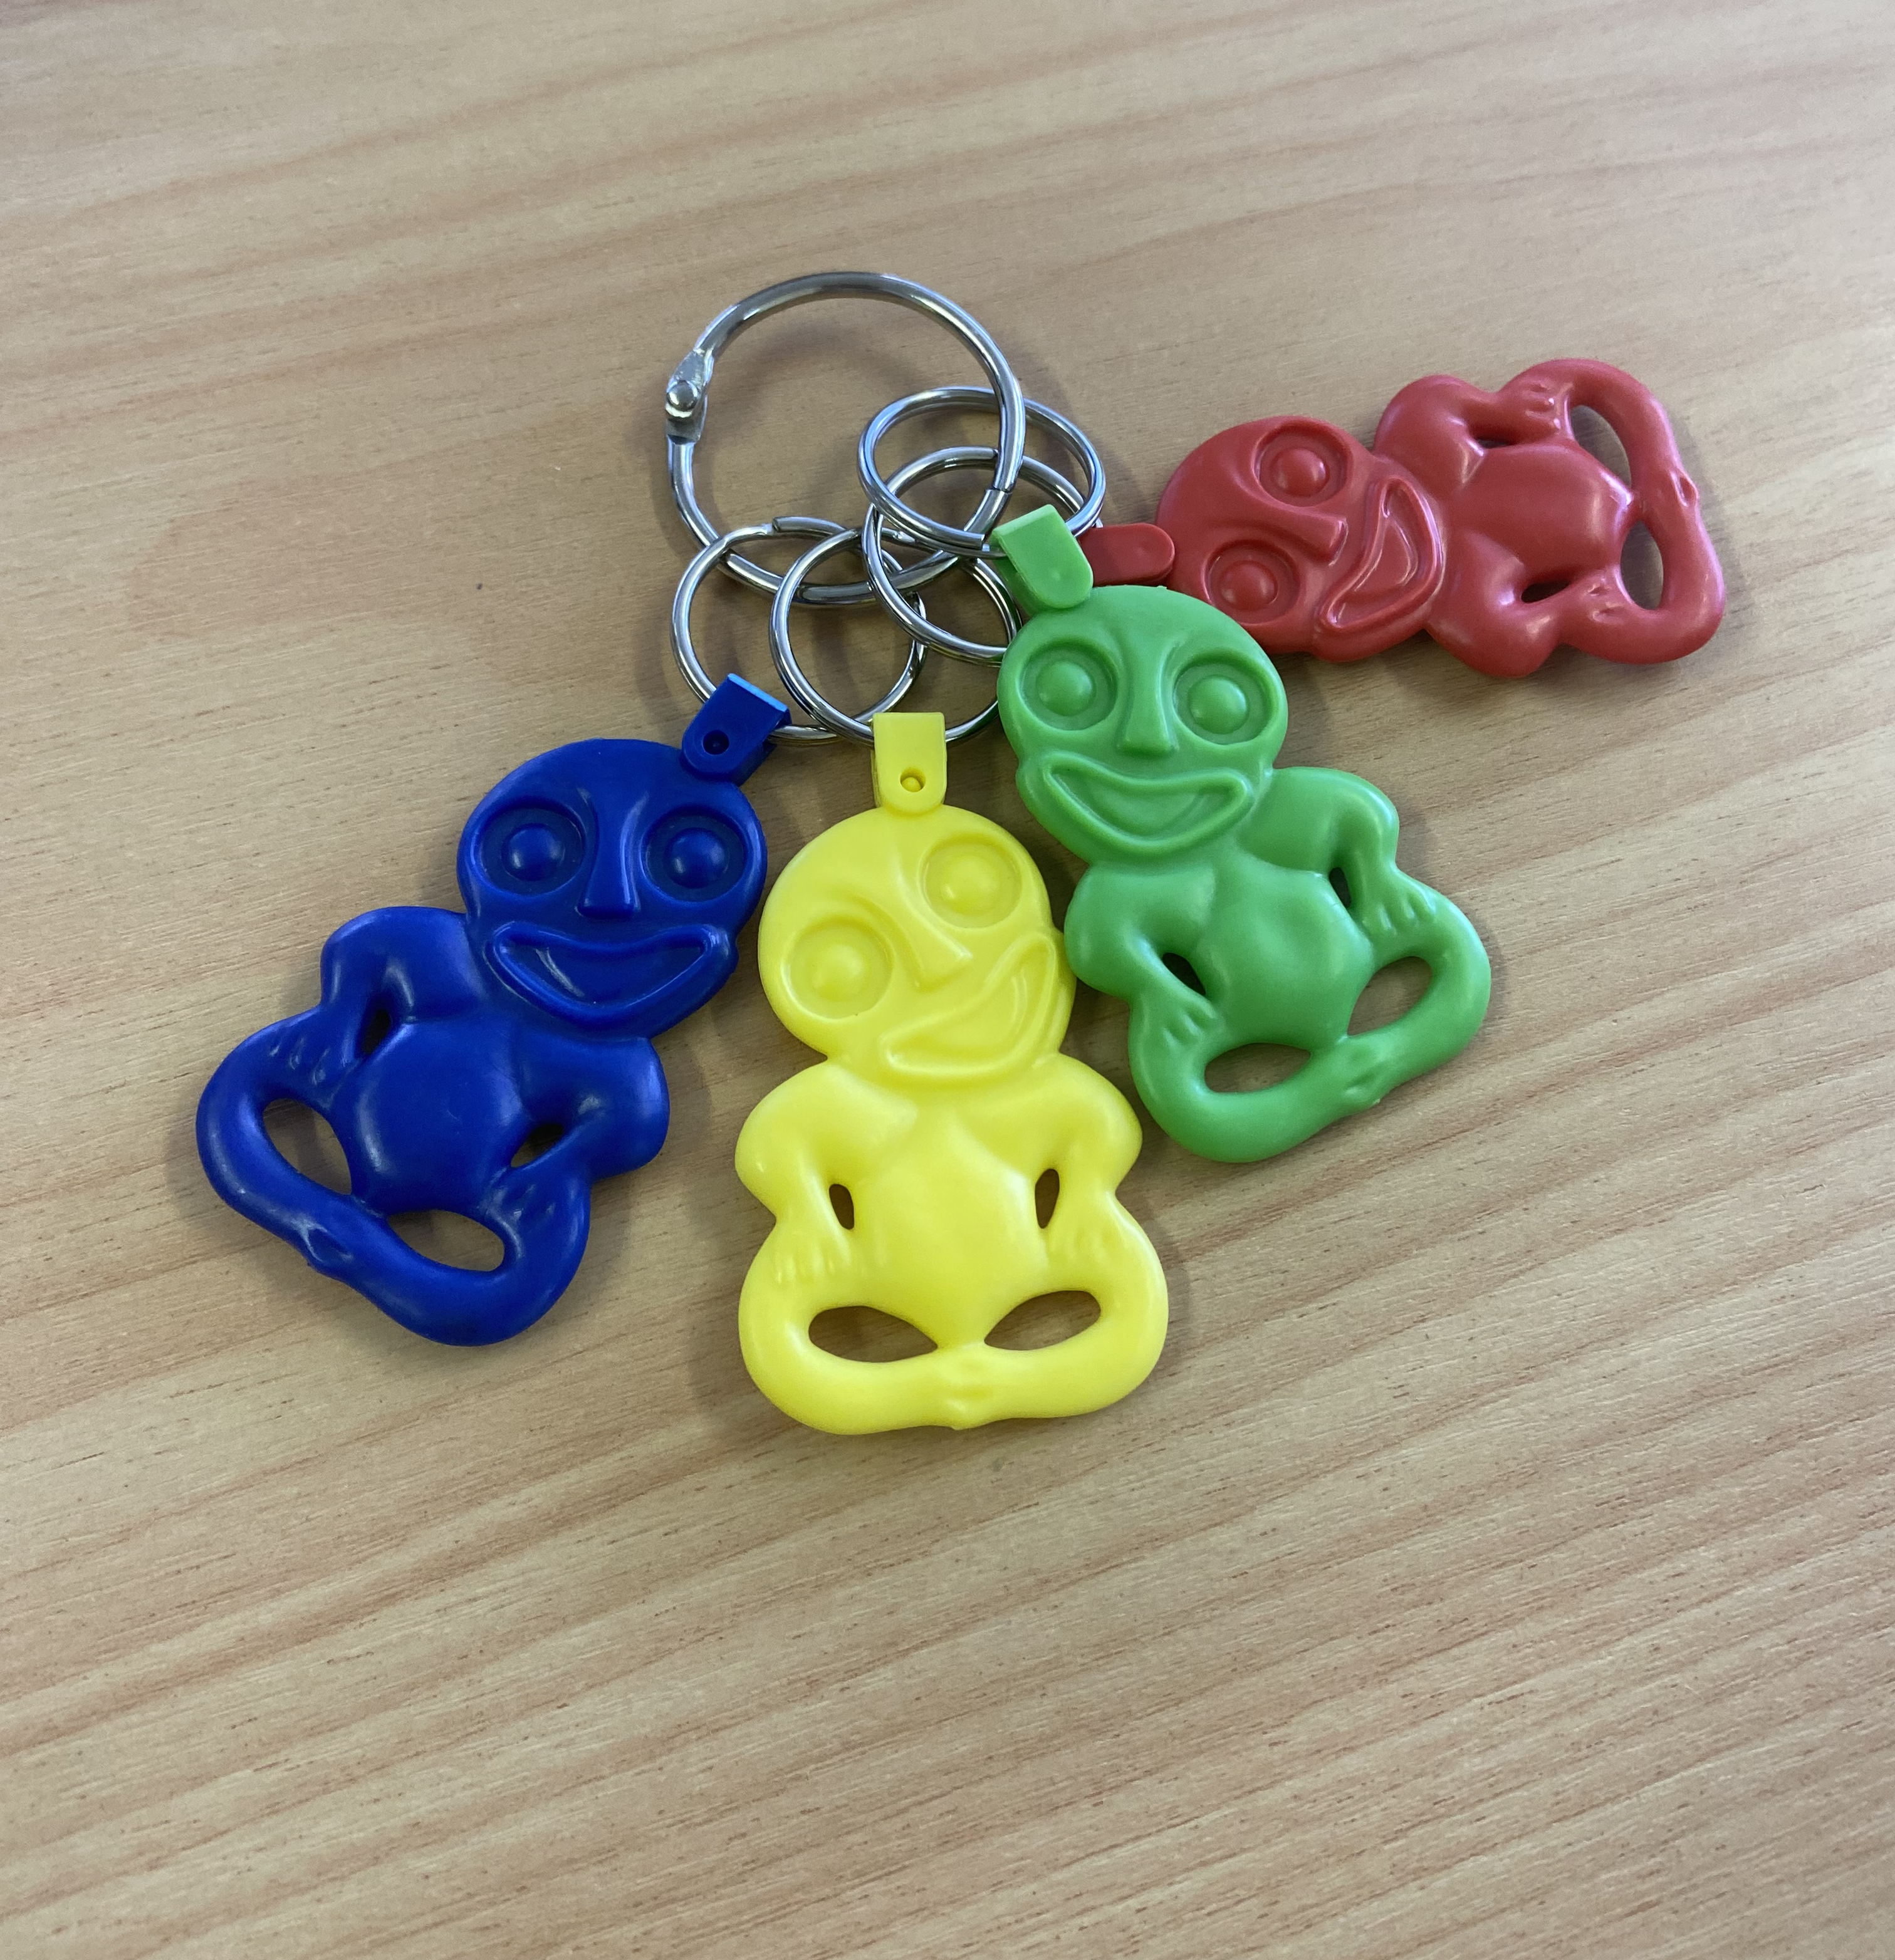
Display examples
Notes:
Alisha

Slide 8
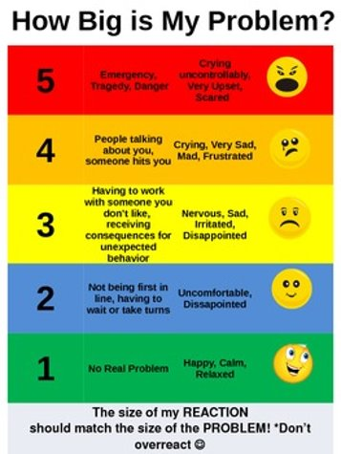
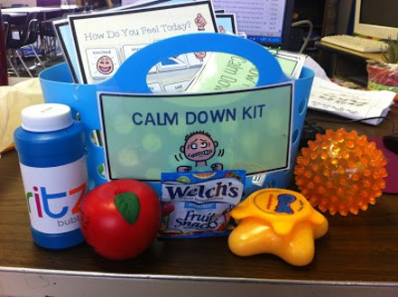
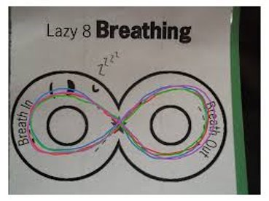
Toolbox ideas

Slide 9
What zone would you be in.........
The Blue Zone: Low state of alertness. This is when your body and/or brain is moving slowly or sluggishly.
The Green Zone: a regulated state of alertness. This is the zone you generally need to be in, to be ready to learn.
The Yellow Zone: a heightened state of alertness. A person is experiencing slightly elevated emotions and is starting to lose some control.
The Red Zone: extremely heightened state of alertness or very intense feelings. A person could be described as “not in control” of their body or their responses.
Notes:
Michele
We all respond differently in situations. It is expected that one could be in the yellow zone if we are suddenly advised that we can't do something that we thought that we could. Or in the red zone if we receive devasting family news.
What zone do you think you would be in. ......
Your at a theme park, with your friends… just got secured into the seat on a rollercoaster ride…. Starts of slowly, then it starts to pick up pace….
Hand up if blue, green, yellow, red
Or
Think back to what zone you were in when you first arrived this morning / or left home. Have you moved between some of the zones throughout the day. Maybe you had drifted into the blue zone just before lunch, then jumped to the yellow zone as you made your way to the eating area.

Slide 10
 | Did not have time for coffee before my 7am meeting. Mood: moving slowly/tired
 | Facilitated a successful whānau meeting Mood: Productive/happy
 | An email arrives from your Team Leader/principal with subject headline “urgent - call me now”. Mood: Worried / Elated ☺☺
 | A parent does not like something you said and 'makes a complaint' Mood: Angry
Teachers: Zones of Regulation
Notes:
Michele:
Here is an example of how you could go through the zones over the course of a day. You can go in and out of all the zones.

