Slide 1
Notes:
Kia ora and Kumusta! My name is Maryanne Manuyag. I am an RTLB with Cluster 8 – Ngā Manu Awhinā. In 2022 I was lucky to receive a TeachNZ scholarship and used this time to complete my Masters through Mindlab where I explored teacher wellbeing in Aotearoa, specifically in my Kahui Ako.

Slide 2
Notes:
With permission from principals, I worked with our Kahui Ako – Te Iti Kahurangi which lies between Maungakiekie and Te Pane o Mataoho. I specifically focused on the primary and intermediate schools within this area and collaborated with the principals to decide on goals that would be beneficial for us all.

Slide 3
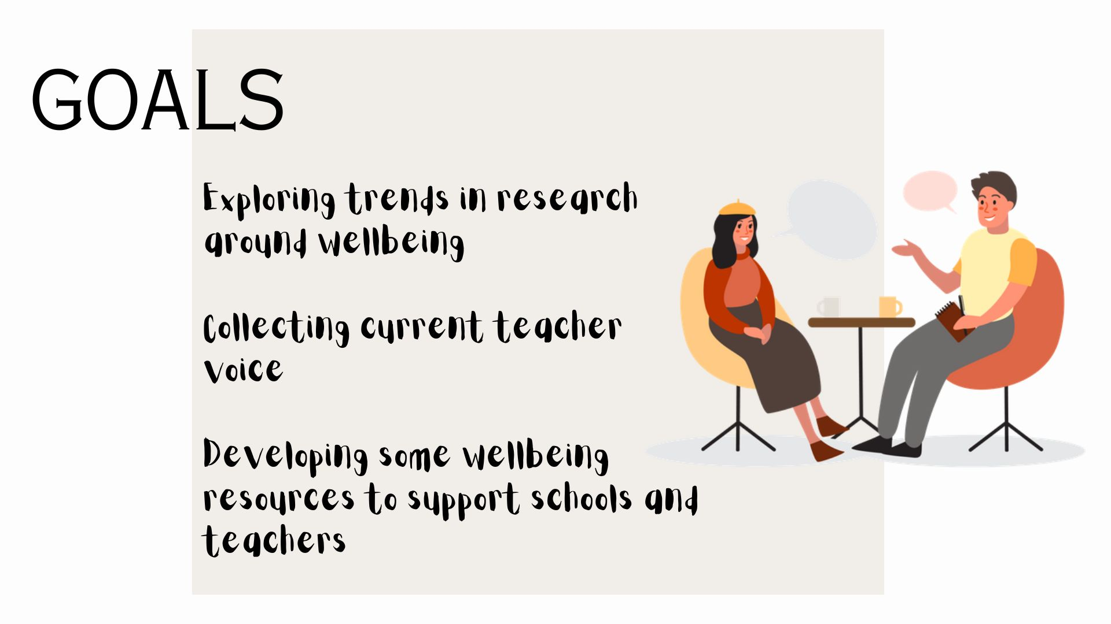
Notes:
The goals we decided on were simple:
1 – Exploring trends in research around wellbeing
2 – Collecting current teacher voice
3 – Developing some wellbeing resources to support schools and teachers

Slide 4
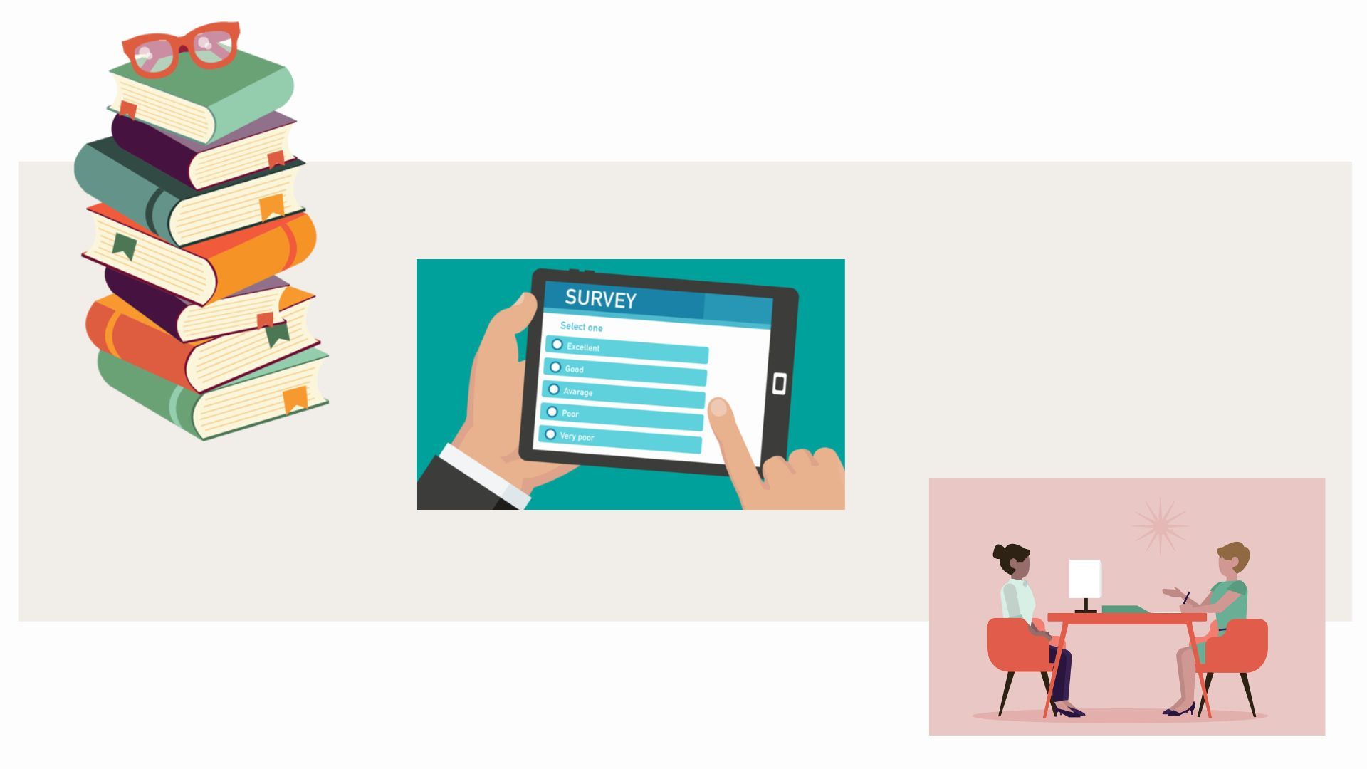
Notes:
Then came a lot of research into what had already been said and collected around teacher wellbeing.
Next, emails with a survey collecting teacher voice from all primary and intermediate schools in our Kahui Ako
Then I conducted interviews with 7 teachers of a variety of ethnicities, genders, teaching experience, self-perceived wellbeing levels and schools

Slide 5
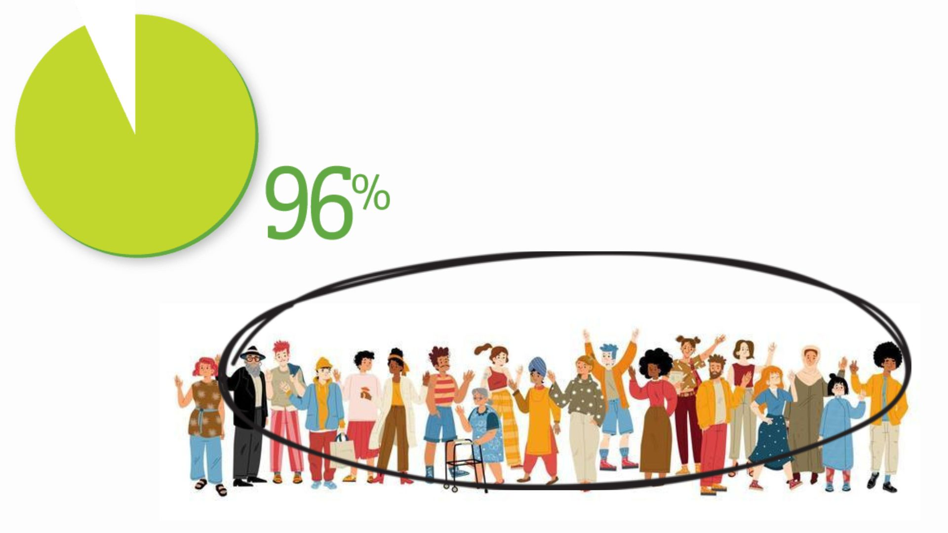
Notes:
One of the most shocking statistics - of all the teachers surveyed 96% said they suffered from mental illnesses such as high stress, anxiety, depression and burnout.
Remember this is from a range of educators with both high and low wellbeing. Let's put this in context – in a school with 20 teachers, 19 are doing their job, while also dealing with some form of mental illness. Research supports this statistic.

Slide 6
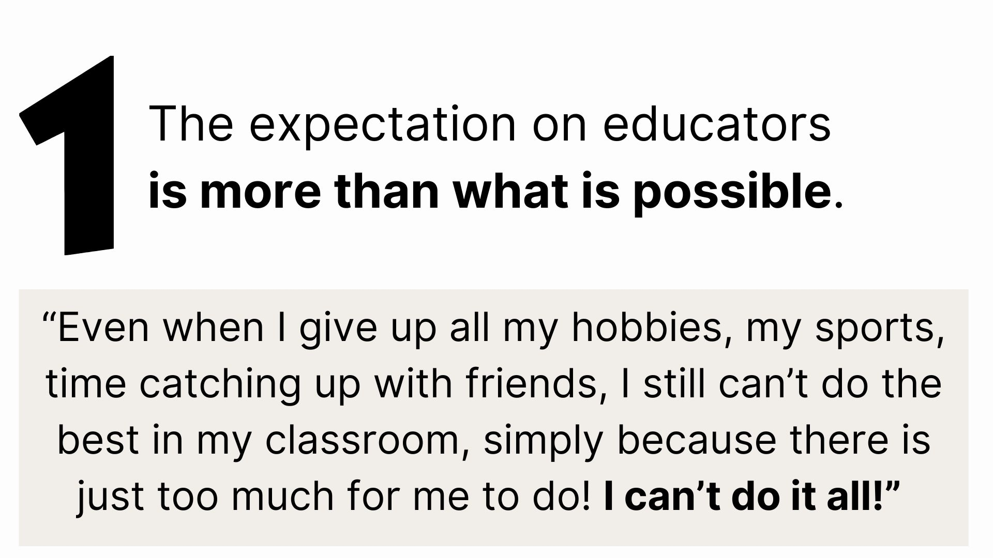
Notes:
Now the themes - The first was the overwhelming statement that the expectation on educators is more than what is possible.
One participant put it like this - “Even when I give up all my hobbies, my sports, time catching up with friends, I still can’t do the best in my classroom, simply because there is just too much for me to do! I can’t do it all!”
43% also said they felt unsafe to approach their management at school for help – partly because they knew their management were also under huge stress and pressure, but also they felt that even taking days off when they were sick was met with frustration and the feeling that they were making things hard for the school by taking time to get well.

Slide 8
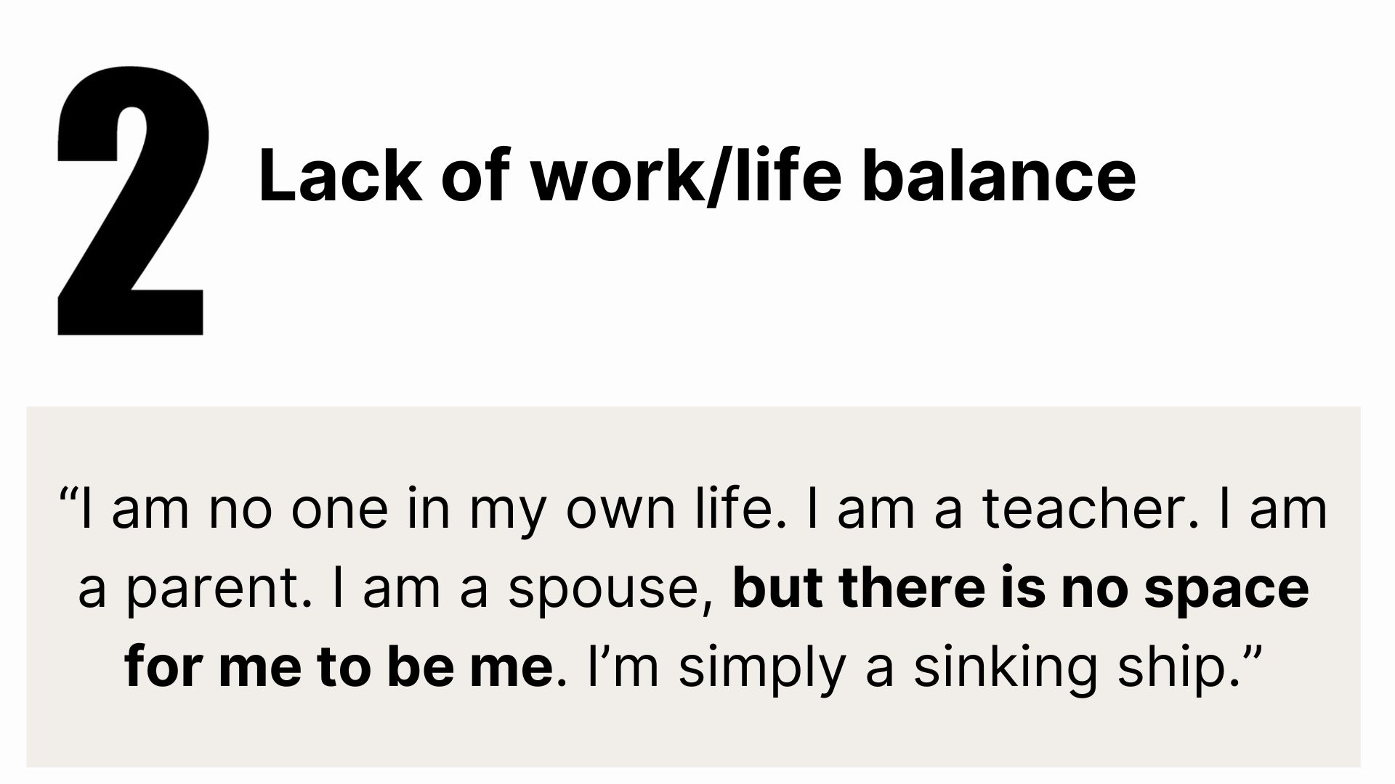
Notes:
The second theme to emerge was the lack of work/life balance.
Many discussed being exhausted and feeling gutted about not being able to prioritise their whānau because of the mountain of work they had to complete at the end of the day.
“I am no one in my own life. I am a teacher. I am a parent. I am a spouse, but there is no space for me to be me. I’m simply a sinking ship.”

Slide 9
Notes:
The third theme was the need for shared responsibility for wellbeing. This was something I was keen to hear teacher voice on as I had heard time and time again that wellbeing is each individual teacher’s responsibility.
Now, 100% of the participants agreed that personal wellbeing – that is the basics – sun, food, water and sleep, should be the responsibility of the person but, and hear this, but there needs to be recognition that in the nature of the teaching role, these basics can be severely affected. “Even people with great wellbeing, if the hurdles are too hard – for example no CRT time, no support from leaders, so many duties that there is no time to eat lunch – healthy or not, even with great wellbeing, you are still going to feel dissatisfied as you can’t live up to expectations and will be affected negatively.”

Slide 10
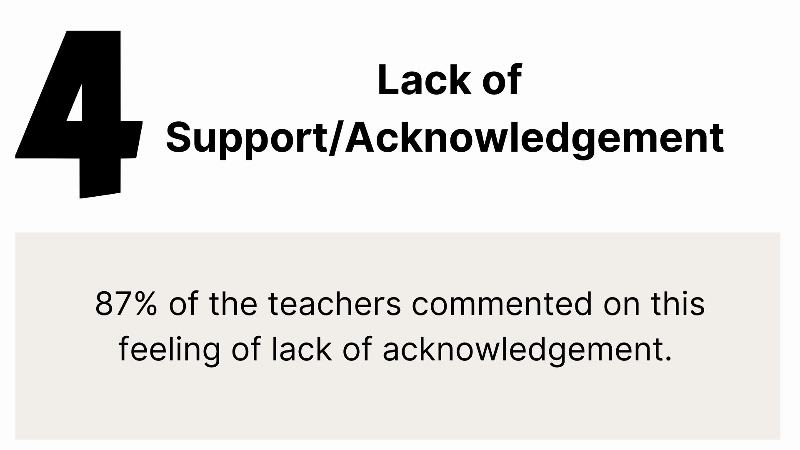
Notes:
The last main theme was the concern around the lack of professional support from school leadership teams.
87% of the teachers commented on this feeling of lack of acknowledgement.
I do love this quote though -
“Our leadership needs recognition too! It is something we all need to be better at - parents, students and even NZEI and the government. We should all be recognising the hard work”

Slide 11
Notes:
I haven’t included COVID-19 this as a main theme in my project as it was a global health issue, not a systemic change that we have any control over.

Slide 12
Notes:
So after all that research and data, now what?
Here research is clear on one thing. This. (Prevention is the key)

Slide 13
Notes:
Research also states that prevention needs to embraced at an organisational level for lasting effect.
Makes sense, right? Independently we need to be looking after our wellbeing, but also as a teaching organisation, we need to be putting things in place to also look after the wellbeing of our teachers!

Slide 14
Notes:
So as part of my Masters, I also created resources for schools to use.
These were also collaborated on by a panel of experts in the Wellbeing area. There was an international wellbeing speaker, a school principal from outside of my Kahui Ako who had a Masters in wellbeing, a Wellbeing specialist, a school counsellor, and an adult counsellor, with many teachers in their caseload.
The discussions was robust, and many adaptions were made until the whole panel were satisfied with the outcomes.

Slide 15
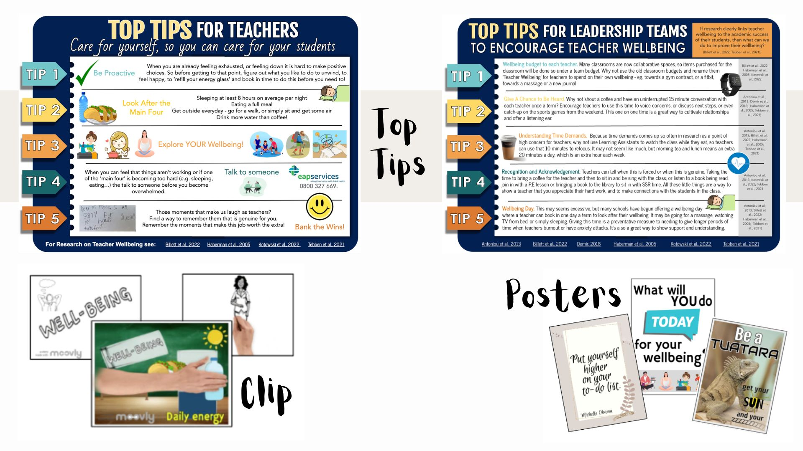
Notes:
To address the individual responsibility for wellbeing, we collaborated on three resources – there was a clip with knowledge around personal wellbeing and strategies to support personal wellbeing, posters to use in a school context to keep wellbeing at the forefront, and a resource called 'Top Tips for Teachers'.
To address how leadership teams can support their teachers, I collated information from research and literature of ways that schools can support their teacher's wellbeing, and strategies that would make this happen.
Now interestingly, the principal on the panel asked if they could use all the resources straight away. And they did in a staff meeting at their school at the beginning of Term 4 in 2022. The whole staff used all the resources and collaborated on changes they could make in their school for how they would approach wellbeing as a collective in 2023. The Board of Trustees also looked at the tips for management teams and implemented all of them! The principal commented on how easy and quick the resources were to use, and the attitude from their staff had at feeling like their wellbeing was being acknowledged and prioritised. ē tū tāngata, they all succeeded together.

Slide 16
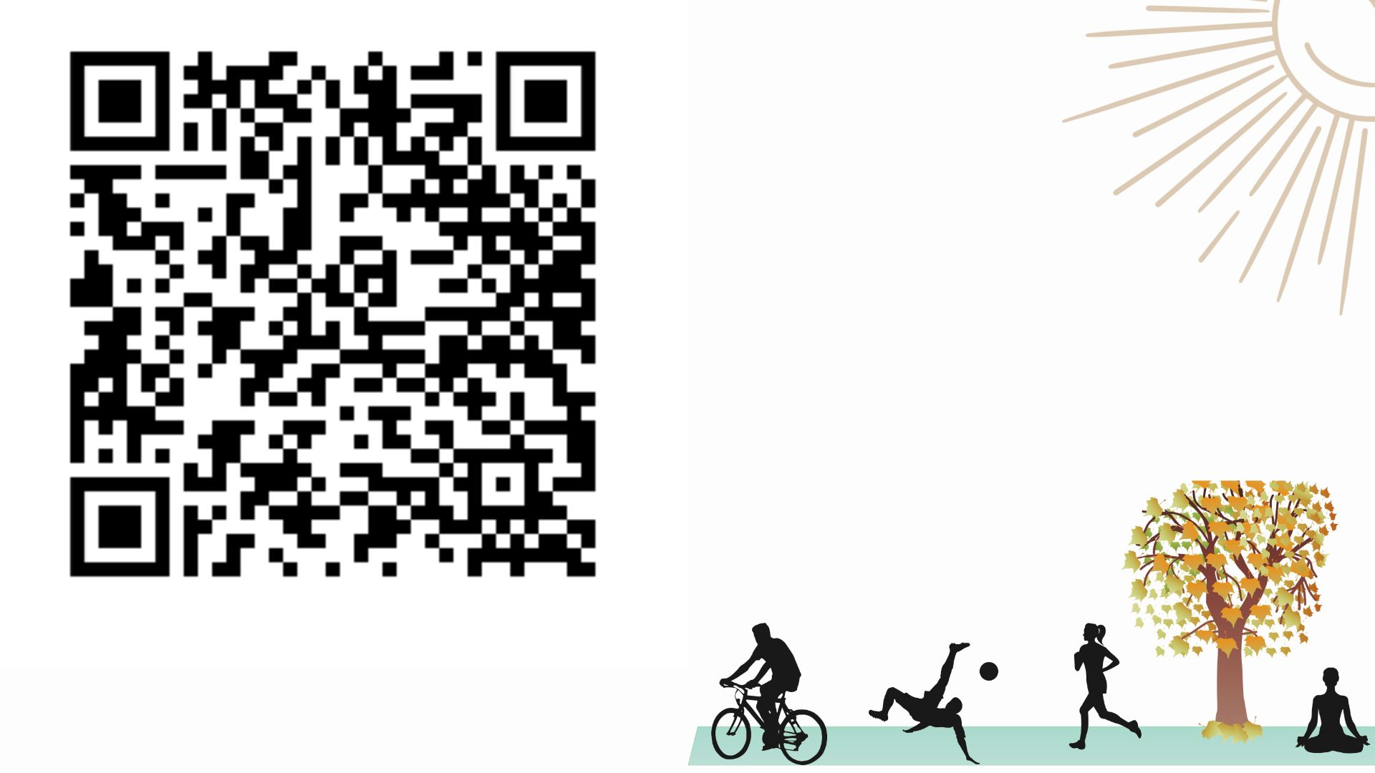
Notes:
Here is the QR code with all the resources I am sharing today for schools to use. They are ready to be used by whomever would like them. Feel free to come up to me to scan the QR code throughout the conference if you missed it today.

Slide 17
Notes:
Me mahi tahi tātu mo te oranga o te katoa
We should be working together for the wellbeing of all. And maybe this was my biggest learning? I think back to that teacher who described themselves as a sinking ship and it reminds me that the possible consequences of ignoring teacher wellbeing are scary and destructive.
But if we can prioritise our teachers wellbeing, then it would be not only be incredible for them individually, but will also have lasting benefits for all - from whānau to mokopuna to our ākonga. Kia Ora.

