Slide 1
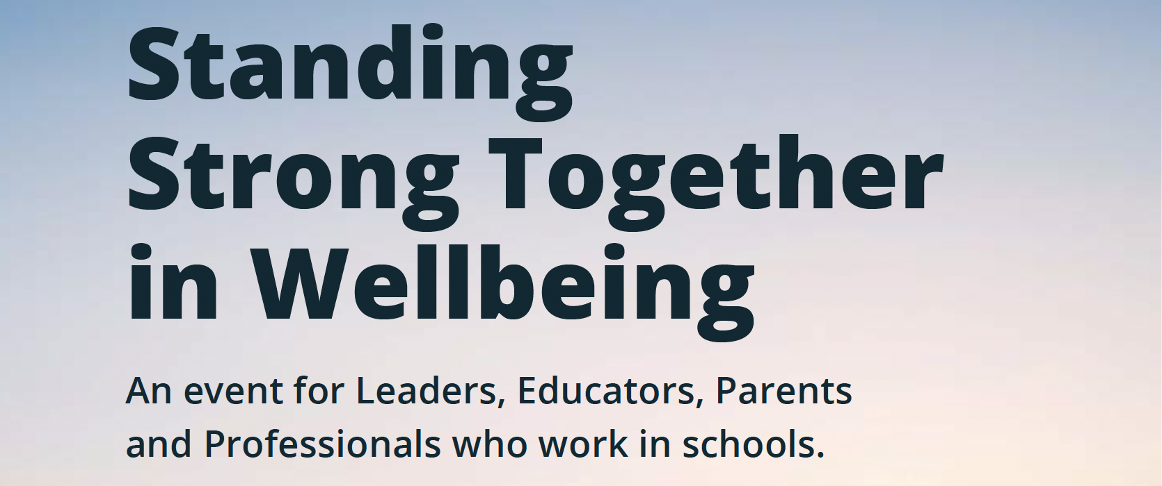
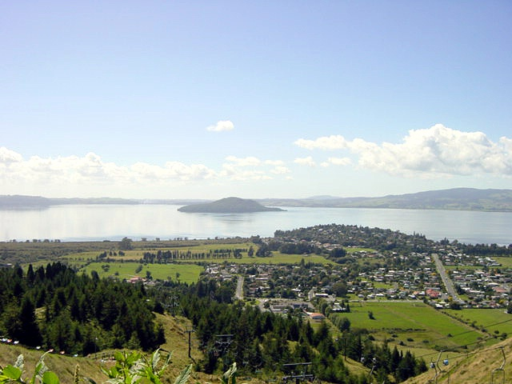
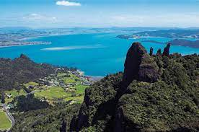
Kia tū rangatira ai: Ākonga motivation, engagement and persistence at school – what matters?
Ngāti Whakaue
Ngāti Hau, Ngāti Hine, Ngāti Kahu

Slide 2
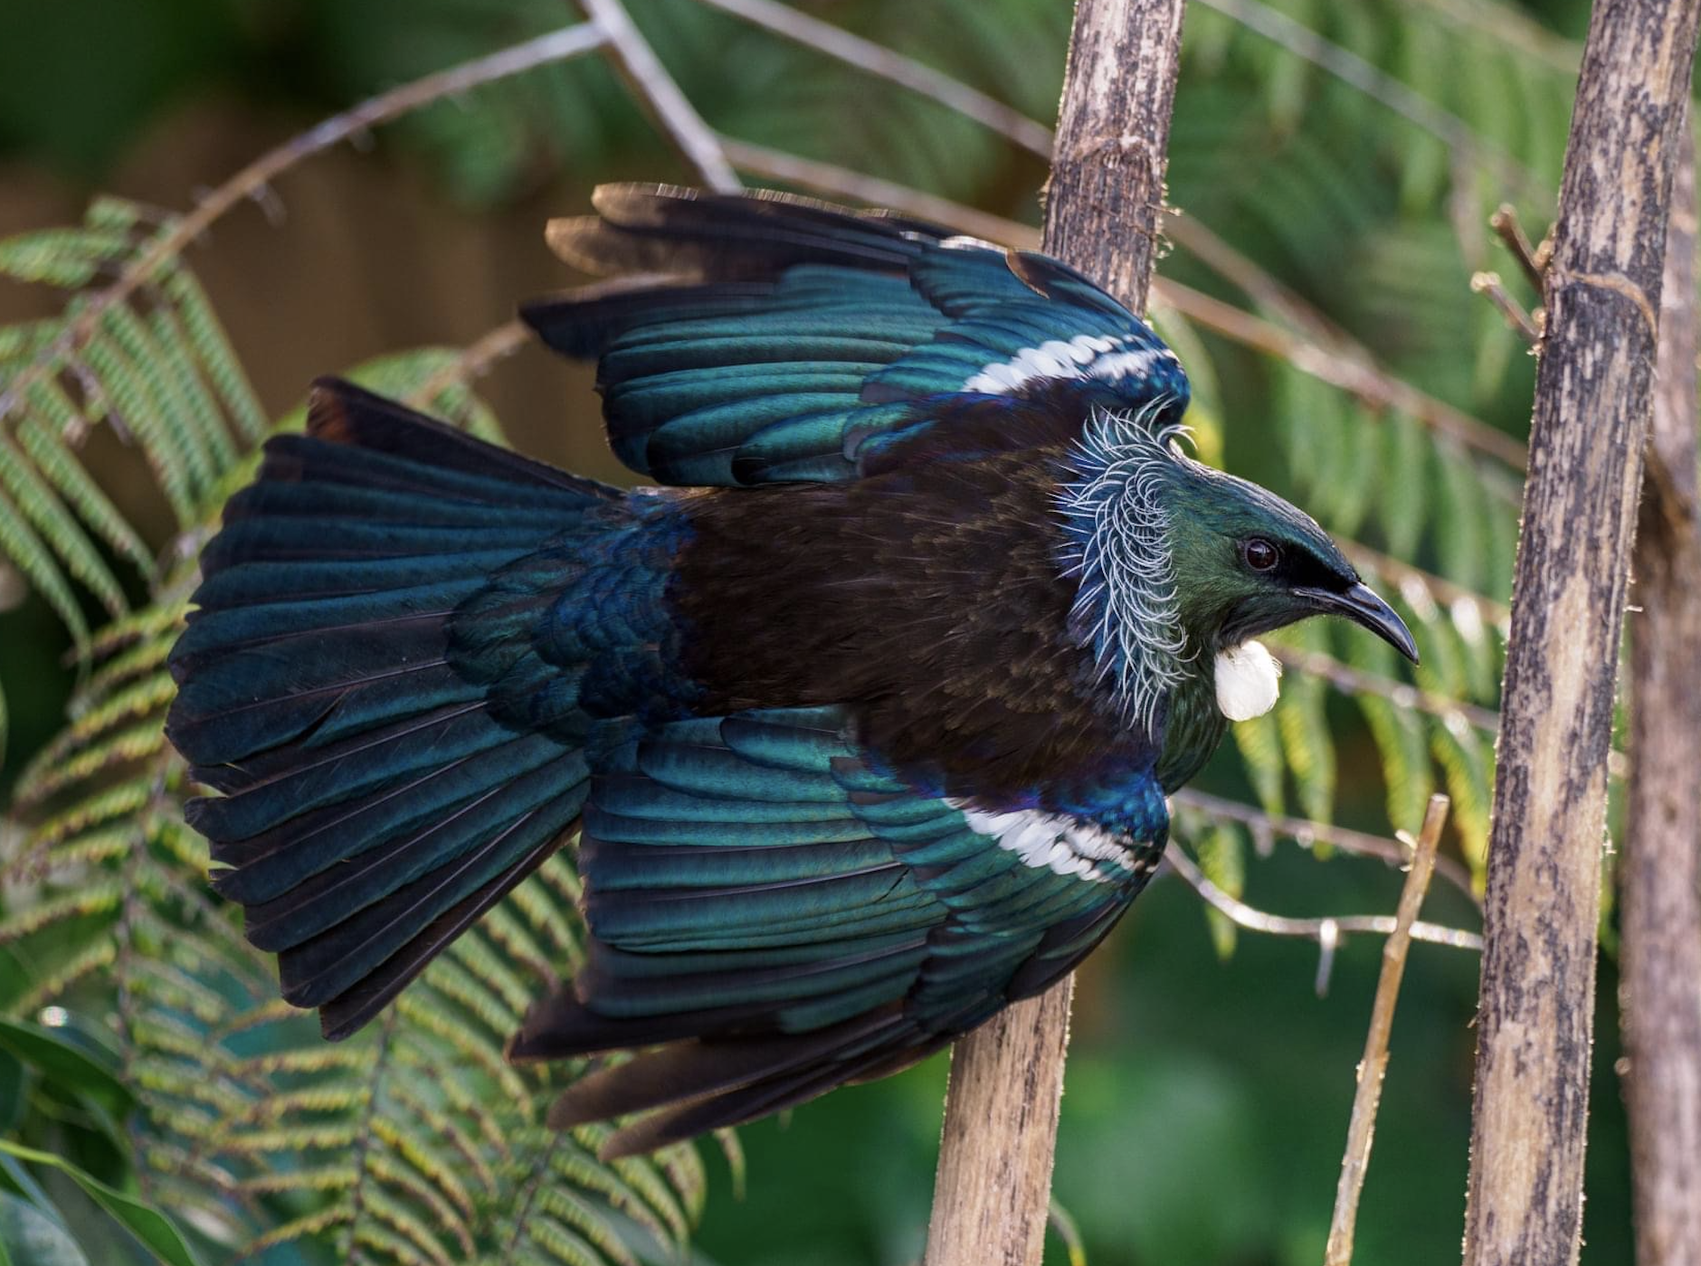
He mana tō te tangata
It is mana (honour, pride and esteem) that lies at the heart of Māori self-worth and the degree to which we feel healthy, empowered and good about ourselves (Royal, 2006).
Mana is “a person’s influence and profound ability to impact upon, affect and positively transform the lives of others” (Dell, 2017, p.93). People who demonstrate mana add dignity to others and provide positive transformation back to communities and people.
Mana tangata, or a secure sense of mana, can influence our thoughts and behaviours, enabling us to act purposefully in the world to achieve our goals and aspirations
A sample question for ākonga:
Identify someone you think has mana. How do they positively transform the lives of others around them?

Slide 3
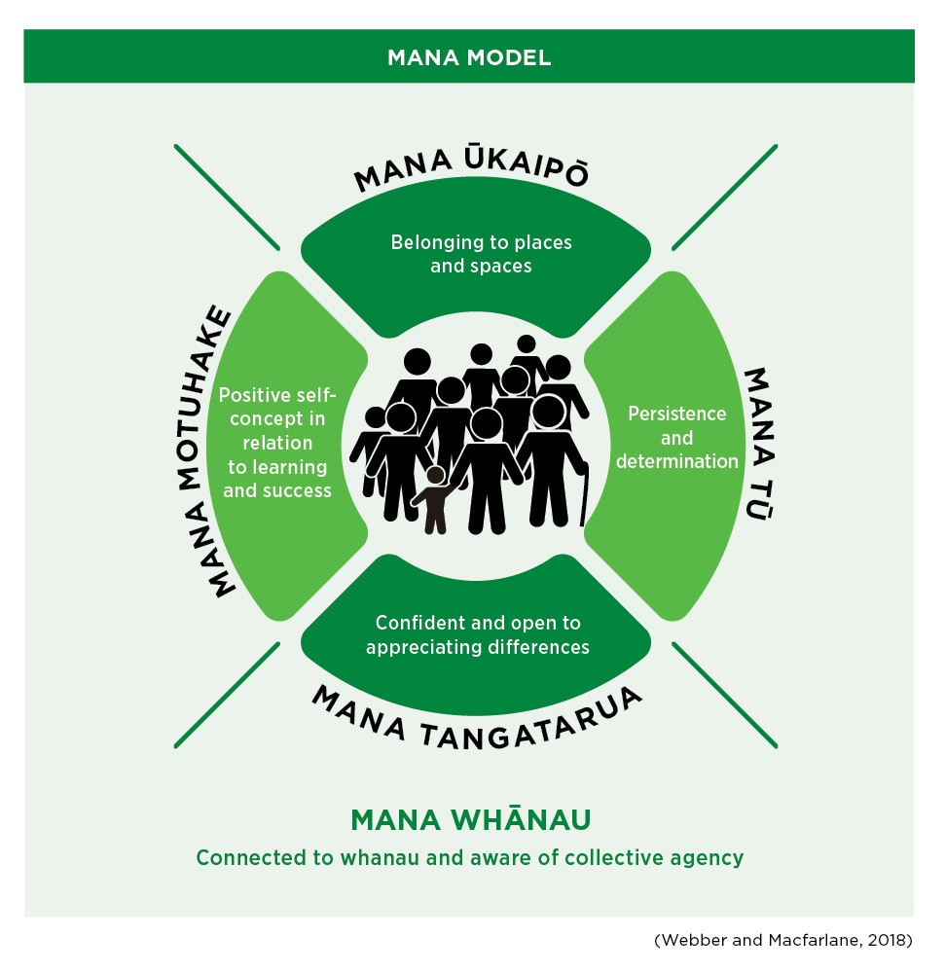
The Mana Model suggests that student thinking, behaviour and wellbeing is motivated by the desire to achieve a sense of mana - self-efficacy, purpose, pride and belonging

Slide 4
Mana Whānau: Connectedness to others and collective agency
Students need to believe that they occupy a central and valued position in their family, including their school family, so they develop a positive sense of self esteem and purpose
Mana Whānau develops when students know:
that their family, peers, teachers and members of the wider school community care about them
Students demonstrate Mana Whānau when they:
have high expectations of themselves
know what their academic strengths and interests are
they can contribute meaningfully to the world around them
that others recognise their innate mana
feel safe and connected to others
have healthy relationships with their peers and teachers
ask for help and feedback where appropriate
believe that they make their family, school and others proud

Slide 5
Mana Ūkaipō: Belonging and relationship to place
Students need to feel belonging and connection to their environment and to others in that environment.
Students thrive when they know that their culture and history is important and valued.
Mana Ūkaipō develops when students know:
that they belong
about where they live and go to school
that their cultural knowledge and history are important and valued
feel connected to others.
Students demonstrate Mana Ūkaipō when they:
feel proud to go to their school
understand how their actions affect others
actively participate in school activities
can talk about their whakapapa, history, culture and language
can compare and contrast different points of view respectfully

Slide 6
Mana Motuhake: Embedded achievement and self-concept
Students need to have a secure sense of cultural identity and positive role models that they can relate and aspire to
Mana Motuhake develops when students know:
Students demonstrate Mana Motuhake when they:
feel proud to be a member of their cultural group.
they have positive role models that they aspire to be like.
their language, culture and identity are an asset
that many people from their cultural group have achieved success
how to manage their time to get important work completed
communicate with clarity and confidence
come to school regularly, on-time and ready to learn
set goals and complete tasks to the best of their ability
use creativity and imagination to problem-solve and innovate
self-assess and make improvements

Slide 7
Mana Tū: Social-psychological competence
Students need the skills to understand and deal with difference and adversity - such as courage, tenacity, self-discipline, humility, self-reflection, and kindness.
Mana Tū develops when students know:
they can learn and be successful
Students demonstrate Mana Tū when they:
respect that everyone learns differently
what they are good at
know what areas they need to work on
they can achieve their goals with hard work, determination, and a “never give up” attitude.
are a generous, kind and humble classmate.
show gratitude when learning from others who think about the world differently to them.
are self-disciplined and make good choices

Slide 8
Mana Tangatarua: A diverse knowledge base and skill set
Students need the skills, knowledge and confidence to navigate two or more worlds with mental wellness, cultural competence, and an inclusive mindset.
Mana Tangatarua develops when students know:
they have something to teach others
Students demonstrate Mana Tangatarua when they:
are interested in learning about other cultures and communities
everyone else has something to offer and teach them
understand and reflect on Māori history, especially the history of their local area
try hard to pronounce peoples’ names and place names properly
are open to new ideas and doing things differently
make decisions with moral courage and integrity
are mindful of the values and needs of others
their languages, cultures and identities are an asset
they can take risks in their learning
other people’s language, culture and identity are an asset
something about what they would like to do when they leave school

Slide 9
Kia tū rangatira ai What motivates students to engage and persist at school?
How do they perceive themselves as learners? What are their attitudes towards school? What job do they want to do in the future? How do teachers and whānau make a positive difference to their learning? What role does culture play in their motivation to succeed? Who are their role models and what do they tell us about what success means to them?

Slide 11
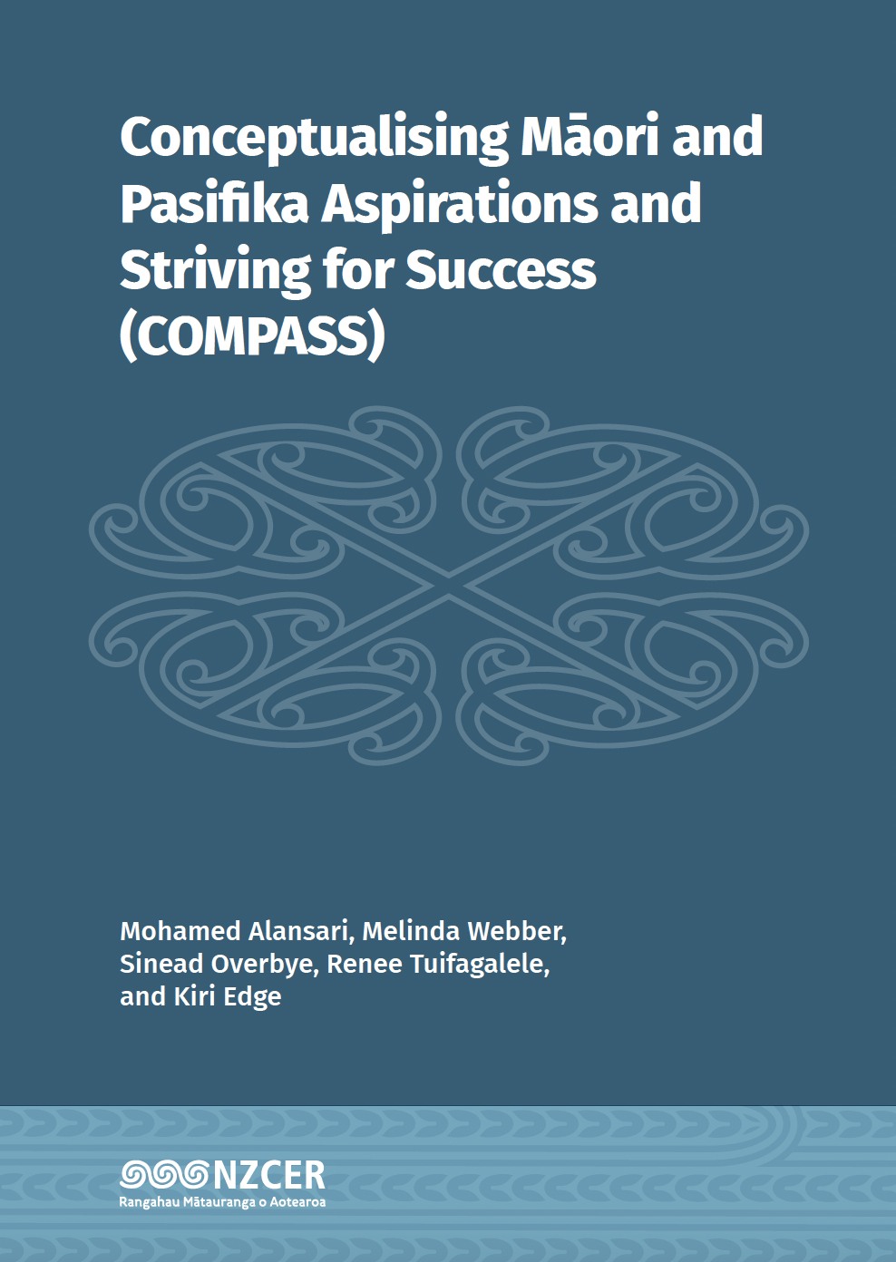
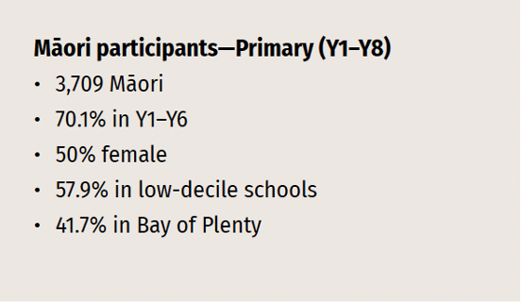
Point of interest
Most Māori learners are motivated, engaged and supported – they are positively motivated to attend school, participate in school activities, report good levels of achievement, feel supported, and are proud of who they are.
Not only were Māori students’ motivation and engagement patterns predictive of their self-reported achievement, but they were also related to their perceptions of support networks and cultural pride.
We found five clusters of motivational and engagement patterns
among Maori primary students:
Flourishing, Thriving, Striving, Surviving, and Struggling
https://www.nzcer.org.nz/research/publications/conceptualising-m-ori-and-pasifika-aspirations-and-striving-success-compass

Slide 12
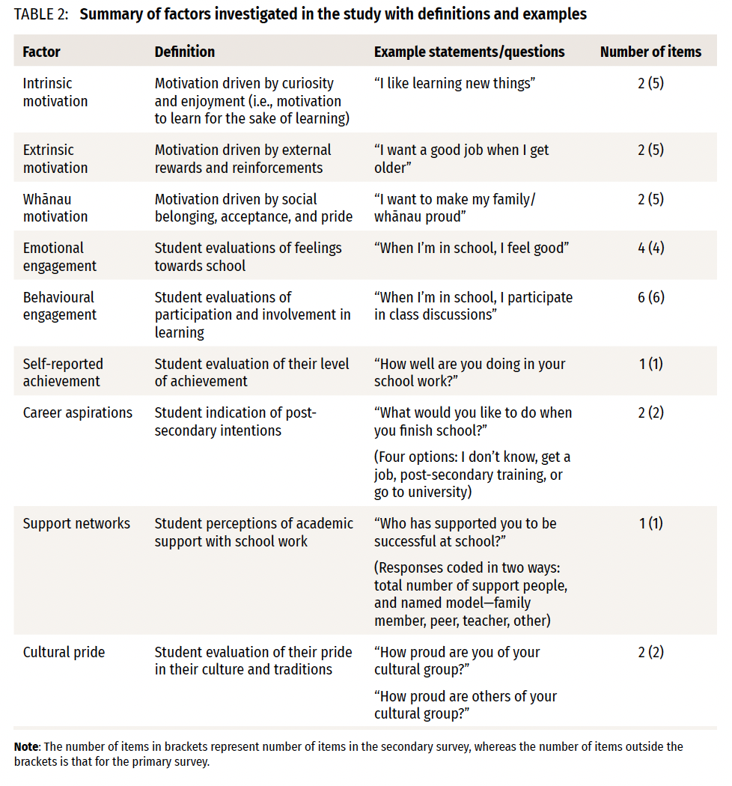

Slide 13
Flourishing Māori primary students
Cluster 1 (n = 831) comprised flourishing Māori who prosper at school because they are highly motivated to achieve and are behaviourally and emotionally engaged.
They report the highest levels of self-reported achievement, cultural pride, and perceptions of cultural status.
Flourishing Māori students are more likely to be female, in Years 1–6, and from low-decile schools. They are more likely to perceive strong whānau and teacher support networks, and only average motivation to get a job or attend university after secondary school.

Slide 14
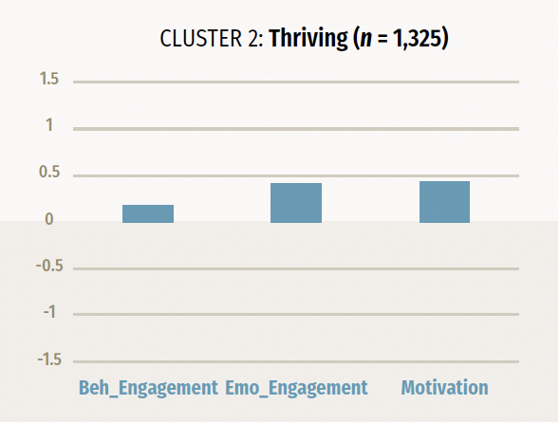
Thriving Māori primary students
Cluster 2 (n = 1,325) comprised thriving Māori who are fully engaged at school and experience slightly above average motivation and behavioural and emotional engagement.
They report average levels of self-reported achievement and high levels of cultural pride and perceptions of cultural status. They have reasonably high numbers of people in their support networks.
Thriving Māori students are slightly more likely to be female, in Years 1–6, and from low-decile schools. They are more likely to perceive strong whānau and teacher support networks, and the highest motivation to get a job and the lowest motivation to attend university after secondary school.

Slide 15
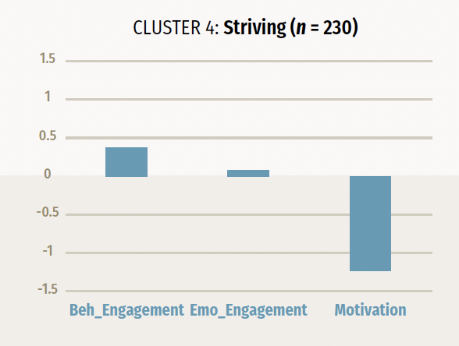
Striving Māori primary students
Cluster 4 (n = 230) comprised striving Māori who are trying to balance the competing demands of school. They have slightly above average behavioural engagement, average emotional engagement, and well below average motivation.
They report low levels of self-reported achievement and cultural pride, and average perceptions of cultural status. They report only average numbers of people in their support networks.
Striving Māori students are slightly more likely to be female, in Years 1–6, and from low-decile schools. They are more likely to perceive low whānau and teacher support, but high peer network supports. They have low motivation to get a job and the highest motivation to attend university after secondary school.

Slide 16
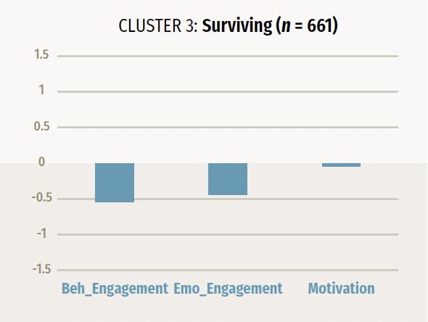
Surviving Māori primary students
Cluster 3 (n = 661) comprised surviving Māori who are making great efforts to achieve at school. They have average motivation, and slightly below average behavioural and emotional engagement.
They report average levels of self-reported achievement, cultural pride, and perceptions of cultural status. They have the highest numbers of people in their support networks.
Surviving Māori students are slightly more likely to be male, in Years 1–6, and from low-decile schools. They perceive high levels of teacher and Whānau support but lower peer network support. They have high motivation to get a job and average motivation to attend university after secondary school.

Slide 17
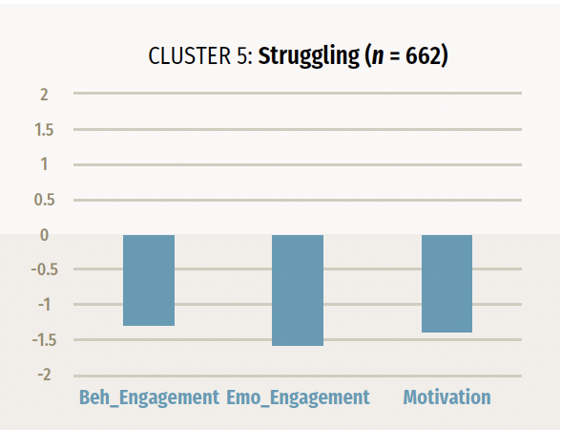
Struggling Māori primary students
Cluster 5 (n = 662) comprised struggling Māori who are apathetic and dissatisfied at school. They have extremely below average levels of motivation and behavioural and emotional engagement.
They report the lowest levels of self-reported achievement, cultural pride, and perceptions of cultural status. They have the lowest numbers of people in their support networks.
Struggling Māori students are slightly more likely to be male, Years 1–8 (a relatively even spread across upper and lower primary contexts), and from low-decile schools. They perceive high levels of whānau support but low levels of teacher support. They have average motivation to get a job and/or attend university after secondary school.

Slide 18
He pātai hei whakawhiti whakaaro…
What motivates ākonga to engage and persist at school?
Are they more intrinsically, extrinsically or whānau motivated? How can you find out and use this information to drive their learning, sense of wellbeing, and academic persistence?
(Mana Whānau, Mana Tū, Mana Tangatarua)
What are ākonga attitudes towards school?
Do they they feel a sense of belonging and safety at school – and if so, where, with whom and why? How can we help ākonga Māori to better understand their strengths, interests and needs? How can we help them to value education, school and learning?
(Mana Whānau, Mana Ūkaipō, Mana Tū, Mana Motuhake) What job do ākonga want to do in the future?
What future careers or future aspirations interest them? How could you help them to think about what skills, knowledges and academic/social strengths do they need to pursue those jobs? What local role models could you engage to ‘inspire’ them in these careers?
(Mana Tū, Mana Ūkaipō, Mana Motuhake, Mana Tangatarua)

Slide 19
Point of Interest Familial and teaching role models are powerful in the lives of ākonga
Primary students:
Secondary students :

Slide 20
Positive role models
The data shows that role models are influential in the life of ākonga Māori. They:
act as behavioral models (they show us how to perform a skill or achieve a goal),
represent the possible (they show us that they goal is attainable – “I can do this, so you can too”),
are inspirational (they motivate us to set aspirational goals and be courageous)
demonstrate the ‘right’ way to do things (in line with whānau, iwi, community, church values – such as humility, reciprocity, mana-enhancing interactions, service ethic, relational)
influence self- stereotyping (through either decreasing the impact of negative stereotypes or increasing the influence of positive self-stereotyping)
In addition, the data shows that ākonga Māori show less interest in, and decide against participating in, fields where Māori are under-represented – but this appears to be more of a motivational issue than a performance issue. In essence, they can’t aspire to be what they can’t see.

Slide 21
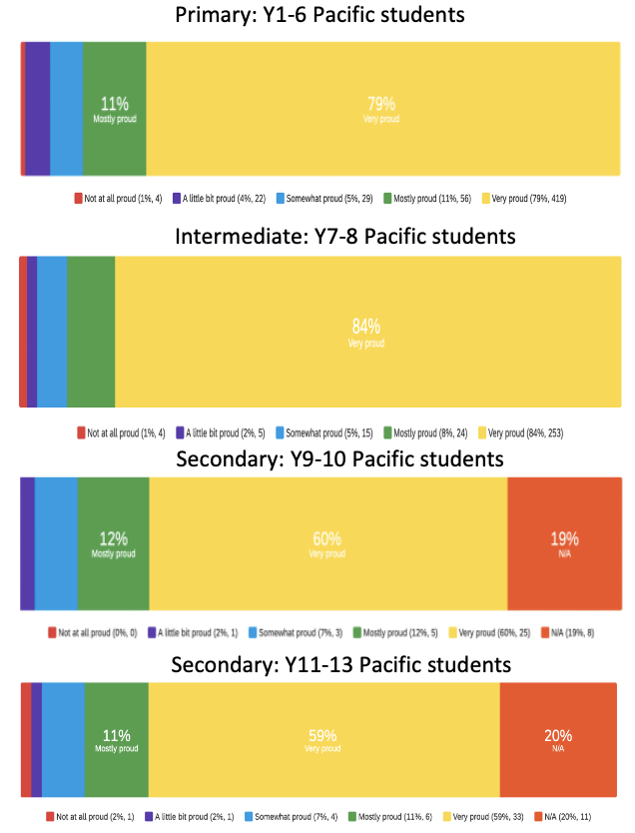
Point of Interest Pākehā cultural pride decreases as students get older
Pākeha students
Māori students
Pacific students

Slide 22
Point of Interest 34% of the parents of Pākehā children could/would not identify a positive aspect of their child’s cultural identity
“na” “I don’t know” “we have no culture” “This question is ridiculous”
“Nothing at the moment - she feels this is an embarrassing time to be European”
“This is hard for me to answer as Pākehā. I honestly don't know”
“Cultural identity not important to us. All ethnicity should be equal”
“I think being white European, we’re not really encouraged by society to be proud of our cultural identity in New Zealand”
“the background is the past…my children think of the future”
“As white, middle class New Zealanders I don't feel our culture is embraced at all. We are so busy being diverse that it's almost shameful to be white working class. We are not allowed to be proud in my opinion”
“I find pakeha in nz dont have much ethnic or cultural background due to the focus of other cultures in nz”

Slide 23
Building cultural efficacy
Maintaining cultural pride and connection in the everchanging national context requires all students to know who they are, how they belong, and how they relate to other groups of people in this place. We must ensure they feel proud of who they are, where they come from and what their culture has to offer the world. As the world around them diversifies, it will become more important to be aware of the values and practices of our own culture/s. We also need all students (but particularly Pākehā students) to have an appreciation and willingness to learn about other cultures.

Slide 24
He pātai hei whakawhiti whakaaro…
What do we need to do to increase cultural pride and social cohesion?
What aspects of cultural identity make your students feel proud? What would they like to learn more about in terms of their culture – and others? How could you use this information to encourage more cultural engagement, sharing and pride?
(Mana Whānau, Mana Ūkaipō, Mana Motuhake, Mana Tangatarua) Who are your children’s role models?
Who in your community act as role models for your students? How could you better engage these role models to help students plan for their futures? What do these role models teach us about the drivers of students’ persistence and wellbeing at school?
(Mana Whānau, Mana Ūkaipō, Mana Motuhake)

Slide 25
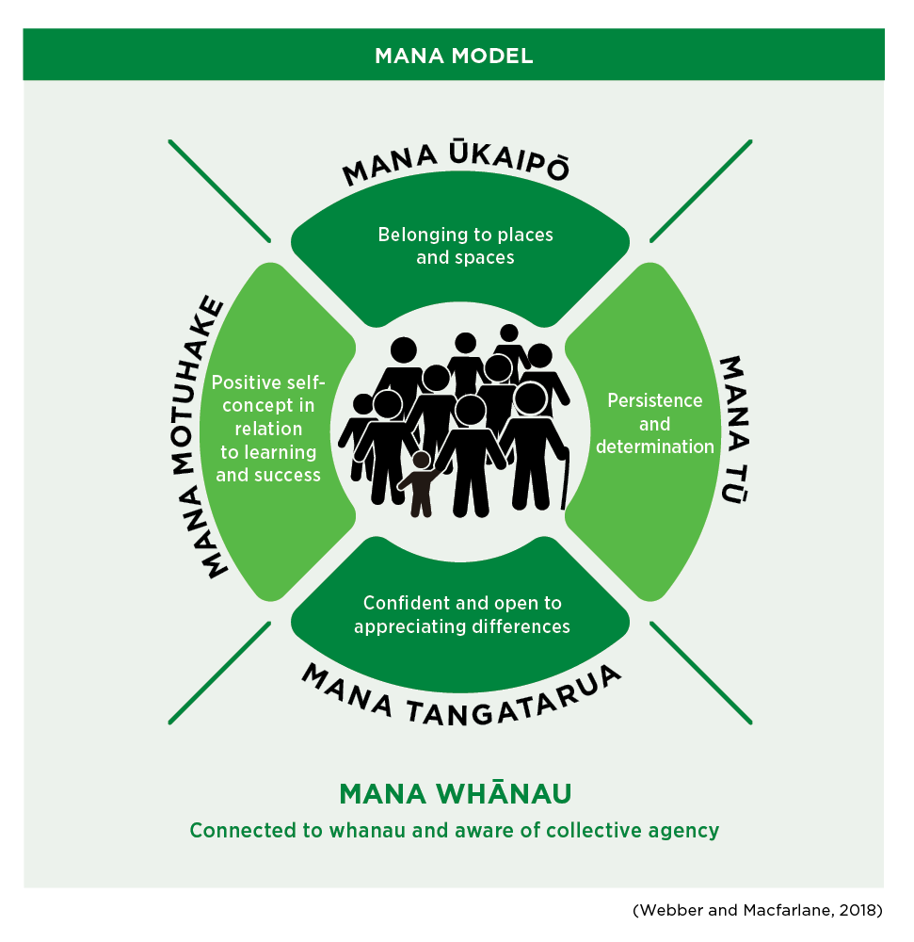
References
Alansari, M., Webber, M., Overbye, S., Tuifagalele, R., & Edge, K. (2022). Conceptualising Māori and Pasifika aspirations and striving for success (COMPASS). New Zealand Council for Educational Research
Highfield, C. & Webber, M. (2021). Mana Ūkaipō: Enhancing Māori engagement through pedagogies of connection and belonging. New Zealand Journal of Educational Studies, 56(2), 145-164
Webber, M., & Macfarlane, A. (2020). Mana Tangata: The Five Optimal Cultural Conditions for Māori Student Success. Journal of American Indian Education, 59(1), 26-49.
Webber, M. & Waru-Benson, S. (2022). The role of cultural connectedness and ethnic group belonging to the social-emotional wellbeing of diverse students. In T. Olsen and H. Sollid (Eds.) Indigenous Citizenship and Education, Pp 294-312. Norway: Scandinavian University Press.
Webber M. (2019). The Development of Mana: Five Optimal Conditions for Gifted Māori Student Success. In: Smith S. (eds) Handbook of Giftedness and Talent Development in the Asia-Pacific. (pp. 671-691). Springer International Handbooks of Education. Springer, Singapore

