Slide 1
BOUNCE BACK
A Social & Emotional Learning Programme

Slide 2
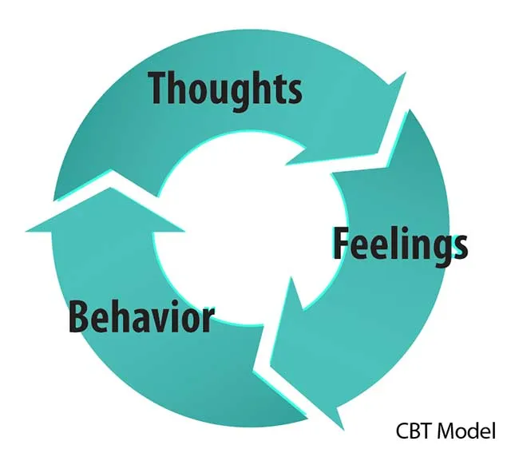
Positive psychology Cognitive Behaviour Therapy (CBT)

Slide 3
BOUNCE BACK Curriculum
Core Values
Social values
People bouncing back
Courage
Looking on the bright side
Emotions
Relationships
Humour
Being safe
success

Slide 4
Lesson Planning
Learning Intention
Resources
Circle Time (Discussion, Questioning, Generalising)
Activity (flexibility)
Plenary

Slide 5
ASSESSMENT TOolS & Assessing change
Changes in student behaviour (seeing desired behaviours)
Improved peer relationships
Fewer school absences by students
Fewer sick days by staff
Lower rates of playground disputes
Capturing student voice
Positive feedback from whānau
Improved learning outcomes for ākonga
Reduction in bullying incidents
Higher Overall Scores in pre/post wellbeing data e.g., SPOCC TOOL, PRASE TOOL

Slide 6
TEACHER FEEDBACK
Feedback & Insights from Educators…

Slide 7
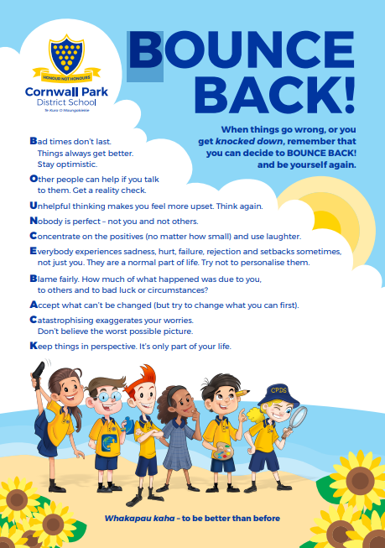

Slide 8
BOUNCE BACK Resource:
https://www.pearson.com/en-au/schools/primary/wellbeing/bounce-bacK
Ka pai ka tūtataki tātou,
mo te oranga o ngā akonga.
It is good to meet together,
for the wellbeing of the learners.

