Slide 1
Mental Health Education Guidelines Facilitated by Tracey Richardson RTLB, Cluster 8

Slide 2
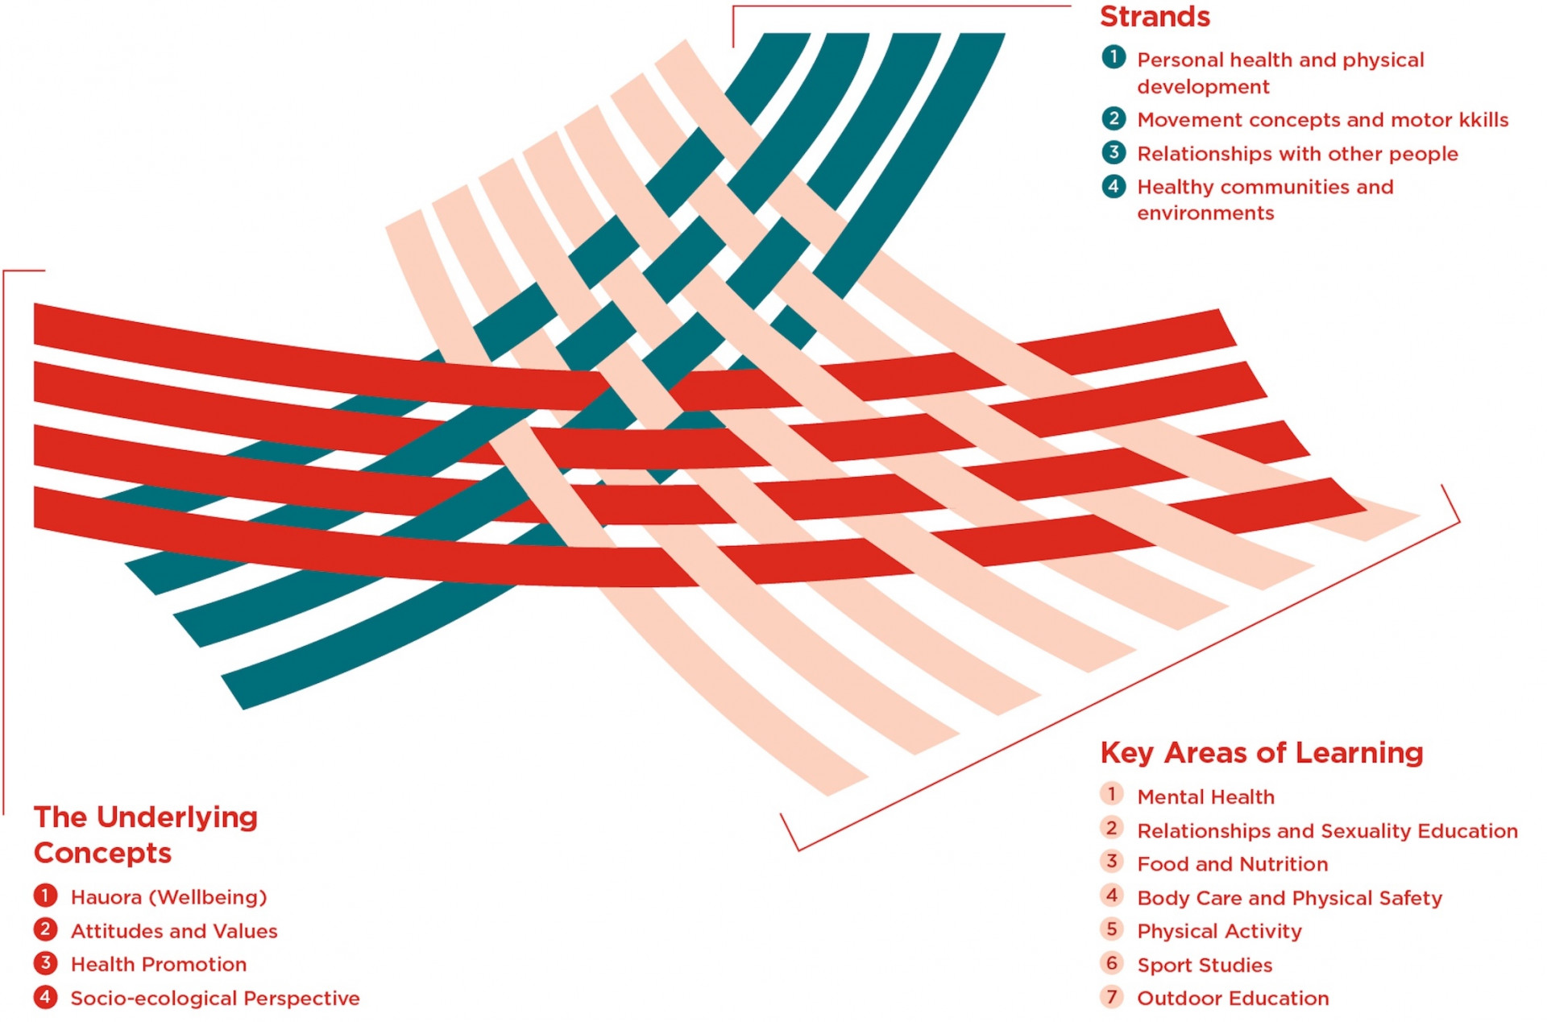
HPE Curriculum (1999)

Slide 3
Mental Health Education: A Guide for Teachers, Leaders and School Boards (MoE, 2022)

Slide 4
Why was this guide created?
It recognises that communities are facing a range of mental health education challenges.
Young people in New Zealand have specifically requested a greater focus on mental health education in schools.

Slide 5
In 2019, researchers surveyed 7,700 Year 9-13 students in Auckland, Northland and Waikato
What did these rangatahi say are the biggest problems for young people?
(Youth2000 Series – University of Auckland)
Take a moment to consider….

Slide 6
The Youth2000 Survey Series explore a broad range of domains that influence adolescent health and wellbeing in NZ. Surveys were conducted in NZ Secondary Schools in 2001, 2007, 2012 and 2019.

Slide 7
Fleming et al (2020) highlighted key themes in young people’s responses to Youth19. They identified big problems for young people today as mental health and pressure, bleak futures and climate change, risky choices relating to easy access to drugs, alcohol and pornography.
When asked what should be changed to support young people in NZ, they said they needed to be listened to and highlighted the need for social, emotional and practical support.

Slide 8
The Government Inquiry into Mental Health and Addiction noted that young people asked for guidance on mental health and how to look after themselves and their friends.
Teachers and school counsellors told the inquiry that they were “overwhelmed by the number of students in distress, the complexity of their issues and the incidence of acting out via problem behaviours in class”
(He Ara Oranga, 2018, page 49)

Slide 9
The Growing Up in New Zealand study noted that “up to 20% of all children and adolescents globally may experience significant mental distress, with onset developing for many before the onset of puberty”
(Morton et al., 2020, page 108)

Slide 10
This is a time of significant global and national change
In NZ we are becoming more aware of the ongoing effects of colonisation and intergenerational trauma on mental health
High rates of bullying
NZ’s high rate of teen suicide

Slide 11
MHEG: One Stop Shop
Download a copy
Access to all the resources, readings and references

Slide 12
Listen to the Principal Writers discuss the guidelines

Slide 13
Overview of Mental Health Education
Definitions
Context within NZC
Role of the school
Partnerships

Slide 14
The guidelines explore the Mana Model
(Webber & Macfarlane, 2020)

Slide 15
Listen to the Melinda Webber discuss the Mana Model

Slide 16
Whole School Approach
Whole school approach and a local curriculum
Three dimensions of school life
Evaluating the WSA

Slide 17
Whole School Approach to Mental Health Education
Check out the guidelines for ideas on getting started or evaluating your WSA to Mental Health Education.
A great local example is the Mitey programme

Slide 18
Alignment
The Mental Health Education Guidelines align with:
Treaty of Waitangi
Human Rights Act (1993)
Child and Youth Wellbeing Strategy
Ka Hikitia
Action Plan for Pacific Education

Slide 19
Mental Health Education and the Curriculum
Designing a programme for years 1-13
Within Health Education and PE
Across the curriculum
Programmes and pedagogies

Slide 20
Examples of learning in Mental Health at different levels
Refer to pages 59-69 of the MHEG for more information and examples of Mental Health Education key learning at different curriculum levels

Slide 21
Access to Mental Health Education for all learners
The guidelines explore ways of increasing access for Māori, Pacific, LGBTQI+, Asian and disabled learners.
Resource links are provided.

Slide 22
What are schools required to do
National Education and Learning Priorities
Section 91/27 of the Education and Training Act 2020
Reviewing programmes
Roles and responsibilities

Slide 23
Requirement for Schools to Consult re: Delivery of Health Curriculum
All schools are required to consult with their community, as required by the Education and Training Act 2020, on how to implement the relevant parts of the health education curriculum at least once every two years.
(Parliamentary Counsel Office, 2020)

Slide 24
When did your school last consult?
Now is a great time to find out when this Health Education consultation occurred at your school.
How was it done?
Who was consulted?
Check out the Mental Health Education Guidelines for details on pages 79-89.

Slide 25
Resources!
References
Links to government policies and strategies
Resource links

Slide 26
“The overall aim of this guide is to enable schools to deliver effective, high-quality mental health education programmes.”
(MoE, 2022, p.7)

Slide 27
Where to next?
Read the document and make a plan!

